Slide 1


Lectures
UMD lectures, Spring, 2021

Slide 2
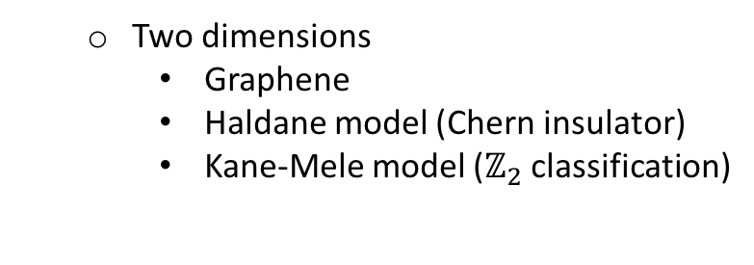
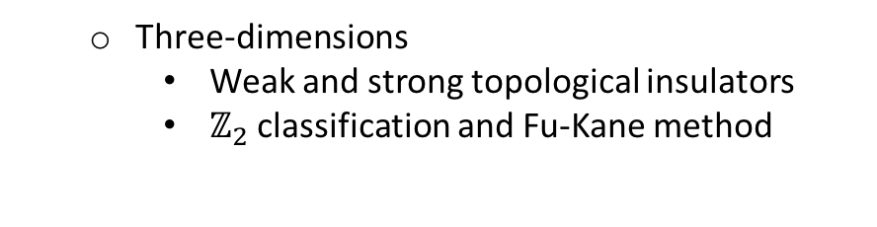
Outline
Preliminaries of the topological band theory
Topological indices and boundary modes
Construction of the topological states and indices
  One dimension (symmetry and topology)
    Su-Schrieffer-Heeger model
    Jackiw-Rebbi zero modes
    Majorana chain
  Two dimensions
    Graphene
    Haldane model (Chern insulator)
    Kane-Mele model ($ℤ_{2}$classification)
  Three-dimensions
    Weak and strong topological insulators
    $ℤ_{2}$classification and Fu-Kane method
    Topological Kondo insulators
    Topology in time: Floquet systems

Slide 3
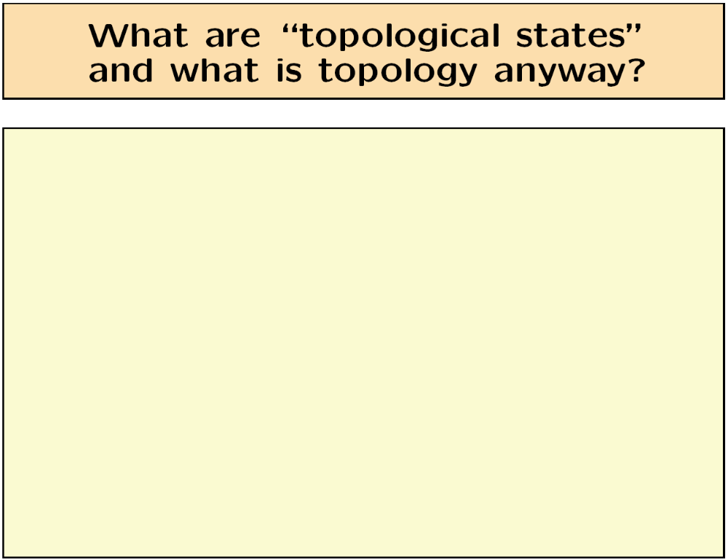

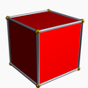
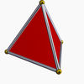

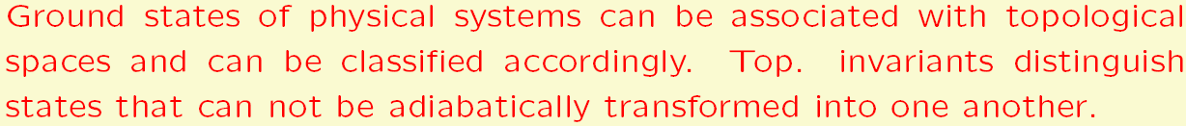

Slide 4
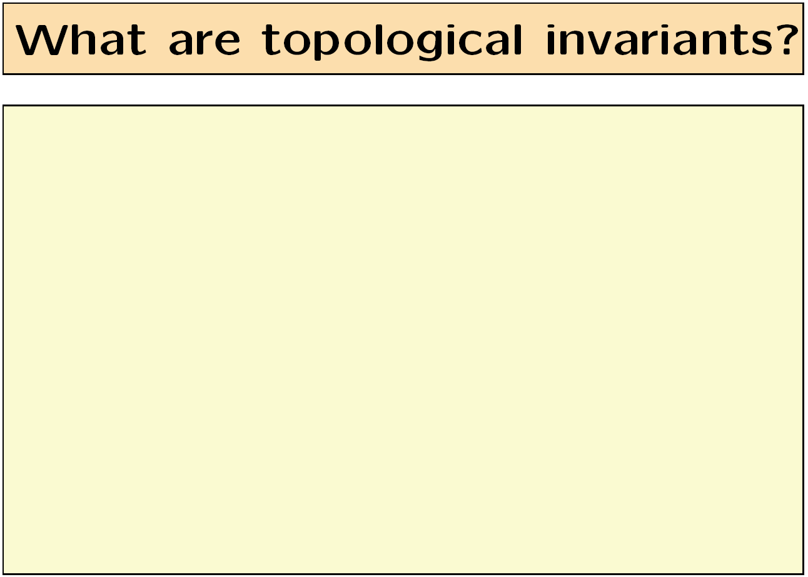
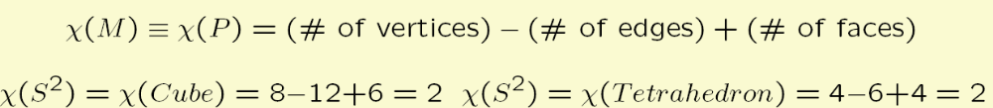

Slide 5



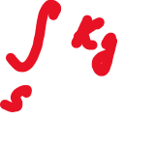








Example of a “useful” top. invariant: Gauss-Bonnet theorem
Can we tell by local measurements whether we are living on the surface of a sphere or a torus?
$$g=0$$
$$g=1$$
Gaussian curvature, $K_{g}=±\frac{1}{R_{1}R_{2}}$

Slide 6
Preliminaries of
the topological band theory

Slide 7

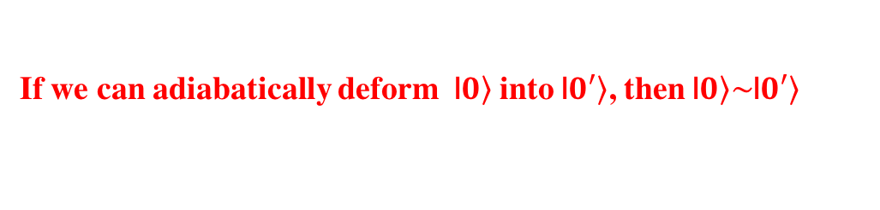


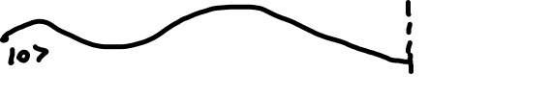

Quantum topological equivalence
How to define topological invariants for quantum states of matter?
We need a notion of topological equivalence of quantum states.
The notion of quantum topological equivalence follows from adiabatic continuity
If we can adiabatically deform |$\left.0\right\rangle$ into |$\left.0′\right\rangle$, then |$\left.0\right\rangle \sim$|$\left.0′\right\rangle$

Slide 8
What are we going to classify?
We are generally interested in classifying (gapped) ground states of interacting many-body systems, which is a very difficult (unsolved) problem.
We will look into non–interacting ground states only.
However, it does not imply that the theory will be useless, once weak interactions are added, because many interacting ground states are known to be adiabatically equivalent to non-interacting models (i.e., a mean-field description is faithful).
For the sake of technical simplicity, we will look into systems with discrete translational symmetry (crystalline solids). They are conveniently described by band theory.
We will develop a topological classification of band structures.

Slide 9
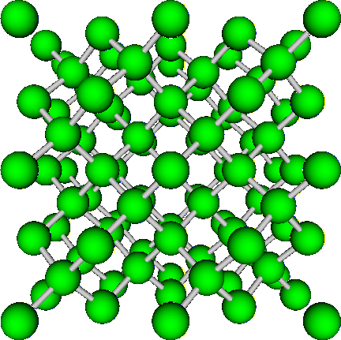
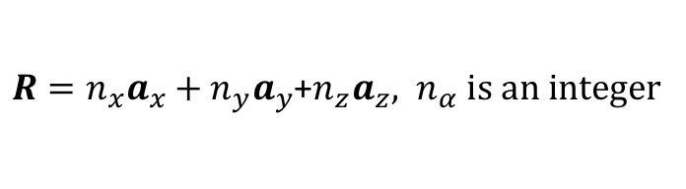



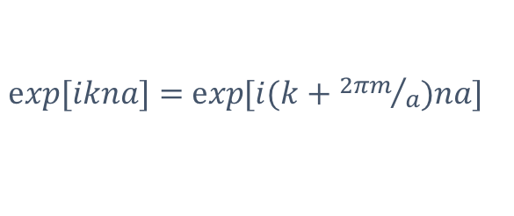

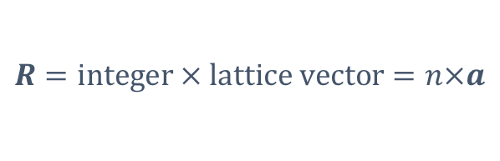
Band theory (elementary reminder)
Electron Hamiltonian commutes with lattice translations
$$\left[\hat{H},\hat{T}(R)\right]=0$$
$R=n_{x}a_{x}+n_{y}a_{y}$+$n_{z}a_{z}, n_{α} is an integer$
$$\hat{T}\left(R\right)|\left.ψ_{k}\right\rangle =e^{ik∙R}|\left.ψ_{k}\right\rangle$$
$$\hat{H}|\left.ψ_{k}\right\rangle =ε_{k}|\left.ψ_{k}\right\rangle$$
Redundancy in the definition of the wave-vector, k. For example, in 1D:
$$|\left.ψ_{k}\right\rangle =e^{ik∙R}|\left.u_{k}\right\rangle$$
$$R=integer × lattice vector=n×a$$
$\exp{[ikna]}=$ $\exp{[i(k+{2πm}/a)na]}$
Bloch wave-function

Slide 10

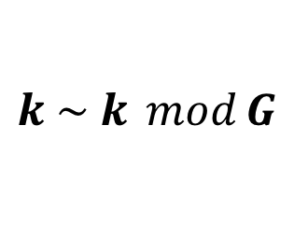

Band structures
The wave vector is defined modulo the reciprocal lattice vector (reciprocal lattice is the Fourier transform of the real-space lattice)
The wave-vector “lives” on a d-dimensional torus (e.g., a circle in 1D).
Allowed energies form bands parameterized by k.
$$k \sim k \operatorname{mod}{G}$$
$k ∈ 𝕋^{d} (1D:−π/a≤k≤π/a$, with the end points “glued”)

Slide 11
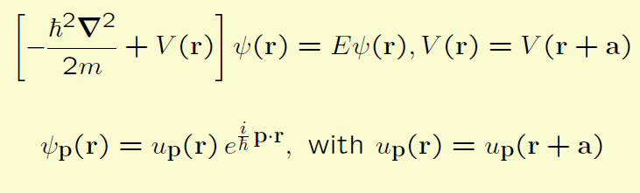
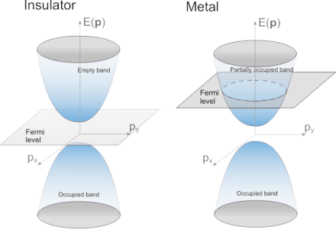
Elementary reminder: insulators and metals
Bloch theorem and band structure:

Slide 12
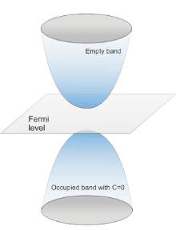
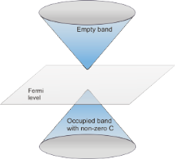



Topological equivalence classes of insulators
Insulator II
Insulator III
Insulator I
Space of all non-interacting Hamiltonians (band structures)
Gap closing (metal)
Symmetry broken
One can define equivalence classes of insulators that can be adiabatically connected (“deformed”)
into one another without closing the gap and/or breaking certain symmetries along the way.

Slide 13
Why topological classification of insulators is important?
Suppose a topological classification of band structures exists (we can assign an integer
index, C, to an insulator) and we have a boundary between insulators with different C’s.
Topological insulator, C=1
Trivial insulator, C=0
There is no way to go smoothly from C=1 to C=0, without closing the gap. So, we must
close the gap or in other words create a boundary metal. This topological metal is
squeezed in between two insulators/vacua and has nowhere to go.

Slide 14
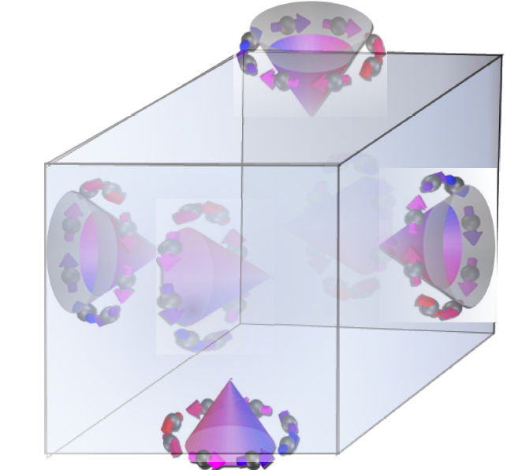
Why topological classification of insulators is important?
Consider a boundary of topological and trivial insulator (e.g., vacuum).
Topological insulator, C=1
3D TI
There is no way to go smoothly from C=1 to C=0, without closing the gap. So, we must
close the gap or in other words create a boundary metal. This topological metal is
squeezed in between two insulators/vacua and has nowhere to go.

Slide 15
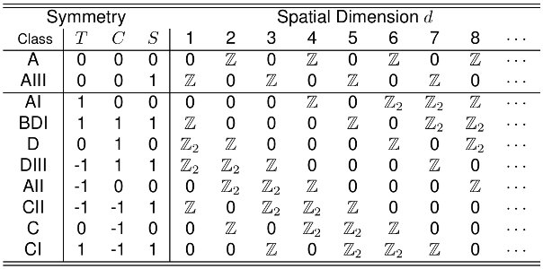
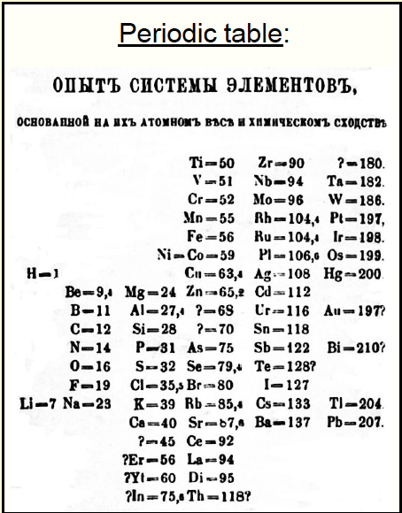
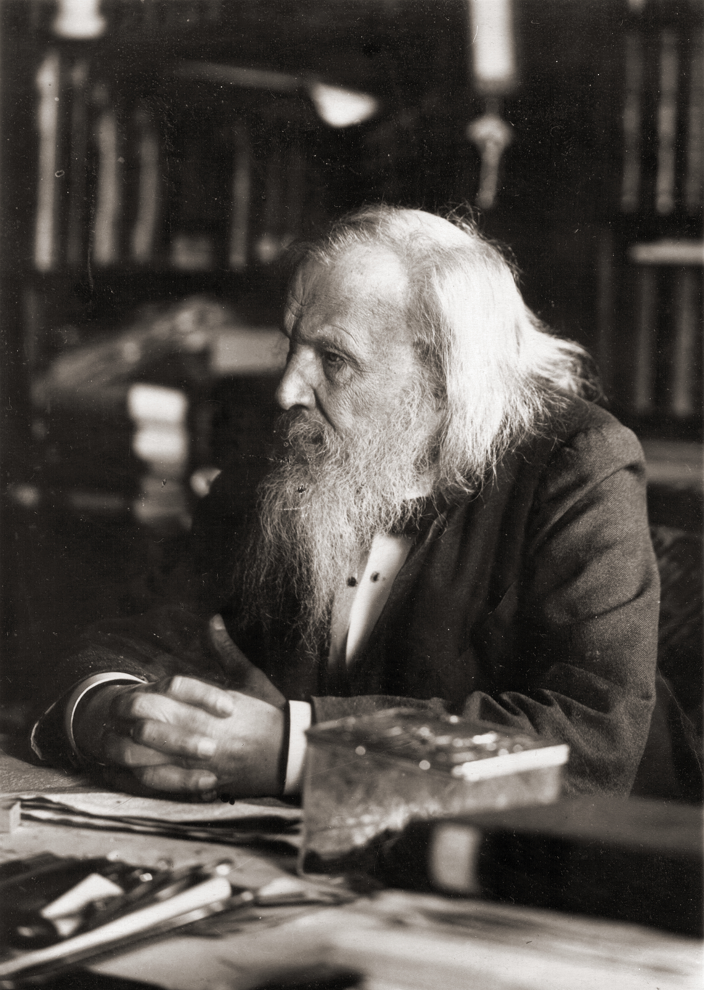
“Periodic table” of topological insulators
19th Century periodic table
21st Century periodic table
"I saw in a dream a table where all elements fell into place as required. Awakening, I immediately wrote it down on a piece of paper, only in one place did a correction later seem necessary.”
Dmitry Mendeleev, 1871
Related to RMT classification by Altland & Zimbauer, Phys. Rev B 55, 1142 (1997) Schnyder, Ryu, Furusaki, & Ludwig, Phys. Rev B 78, 195123 (2008)
Qi, Hughes, & Zhang, Phys. Rev B 79, 195424 (2008)
Kitaev, Advances in Theoretical Physics: Landau Memorial Conference, 22 (2009)
Notes:
T is an anti-unitary operator which commutes with the Hamiltonian.
C is an anti-unitary operator which anti-commutes with the Hamiltonian.
S is a unitary operator which anti-commutes with the Hamiltonian.

Slide 16







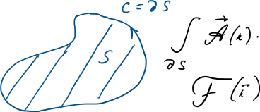



Gauge invariance, Berry connection & curvature
Bloch w.f. is defined up to a phase factor
By analogy with E&M, introduce vector potential (Berry connection)

Slide 17
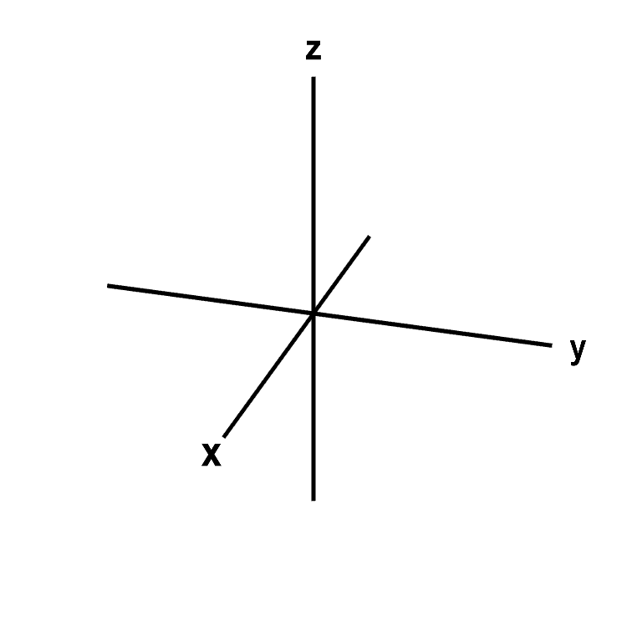


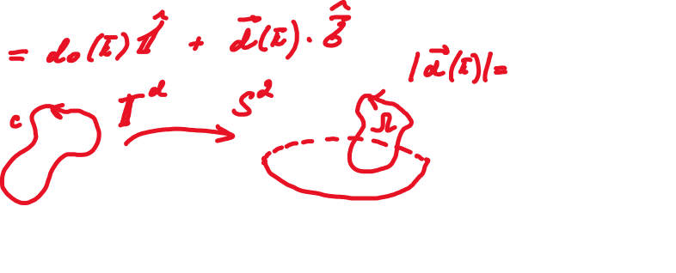














Example: Berry phase in a two-level system
Hamiltonian of a TLS

Slide 18
One dimension
(Su-Schrieffer-Heeger model)

Slide 19

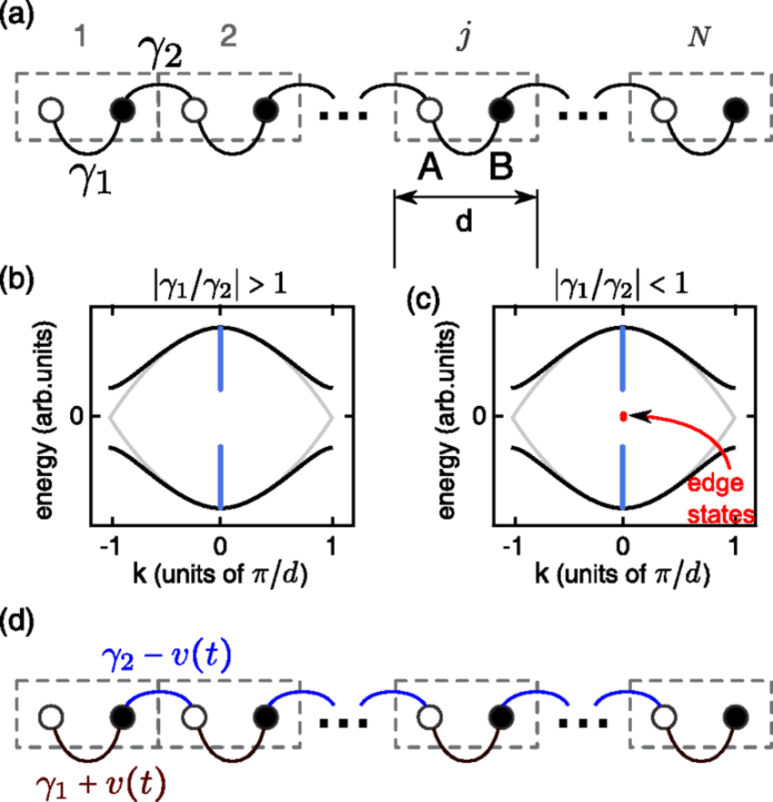





















Topology in 1D: Su-Schrieffer-Heeger (SSH) model

Slide 20
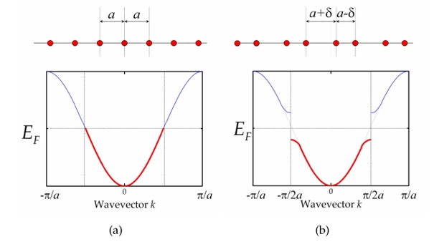







SSH model (continued)

Slide 21


























SSH model (continued)

Slide 22
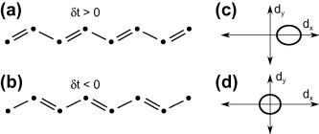















Topological index of the SSH model

Slide 23







What does the topological phase mean?
Consider the stupid limit with either t =0 (topological) or t =0
1
2
E=0 states are protected by a “chiral” symmetry (dz=0) for finite hopping

Slide 25
Outline
Preliminaries of the topological band theory
Topological indices and boundary modes
Construction of the topological states and indices
  One dimension (symmetry and topology)
    Su-Schrieffer-Heeger model
    Jackiw-Rebbi zero modes
    Majorana chain
  Two dimensions
    Graphene
    Haldane model (Chern insulator)
    Kane-Mele model ($ℤ_{2}$classification)
  Three-dimensions
    Weak and strong topological insulators
    $ℤ_{2}$classification and Fu-Kane method
    Topological Kondo insulators
    Topology in time: Floquet systems

Slide 26










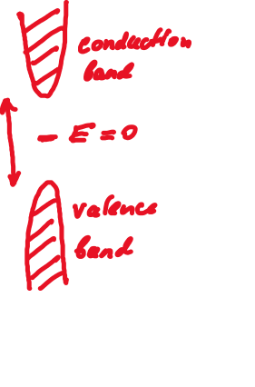





Zero-modes on domain walls

Slide 27
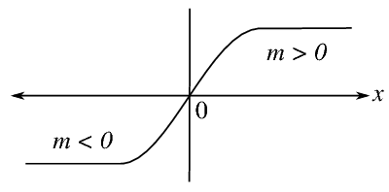






Jackiw-Rebbi states: zero-modes in continuum
In 1976, Jackiw and Rebbi considered a soliton in the Dirac equation (and more complicated case of a Young-Mills monopole) and showed that the topological defects carry half a fermion.
Zero modes in the SSH model and closely related Majorana modes in p-wave superconducting wires are exactly such Jackiw-Rebbi states.

Slide 28
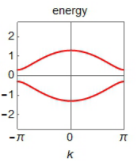












Dirac equation for the SSH model
Consider the SSH model with a small gap
Zoom in near the zone edge
Expand near k= /a + q

Slide 29












Zero modes on the 1D soliton
Consider an inhomogeneous SSH system with a varying m(x)
If m(x) changes sign, it must carry a zero mode. Proof:
A normalizable solution with E=0 always exists!

Slide 30


















Relation to Majorana fermions (Kitaev chain)

Slide 31
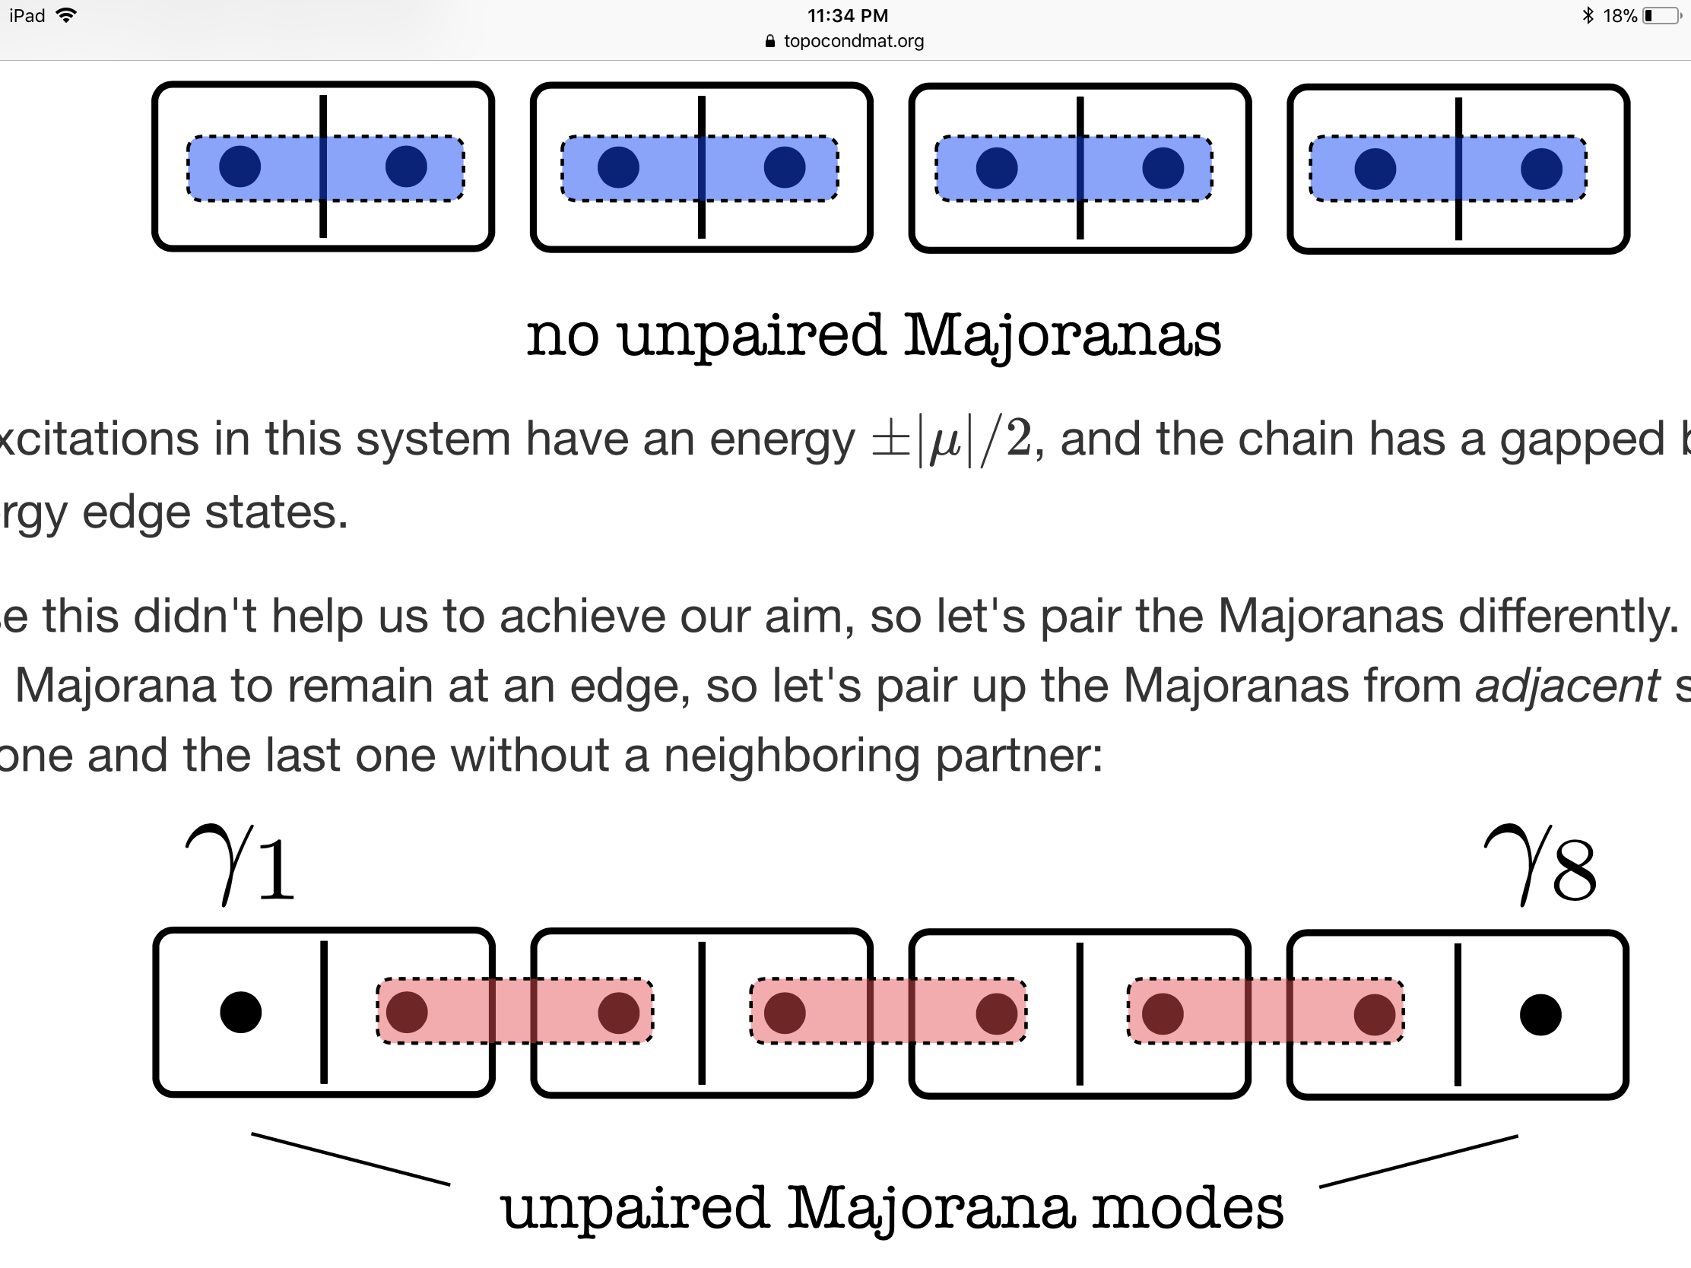












Two phases of the Kitaev chain
Jackiw-Rebbie modes in QFT, dangling bonds in polyacetylene (SSH), and Majorana modes are close cousins.
The zero modes are protected by chiral/PH symmetry.
The symmetry in a superconductor is robust, unlike the “fake” “chiral” symmetry in SSH, which is easily broken.

Slide 32
Two dimensions
(graphene & Haldane model)

Slide 33
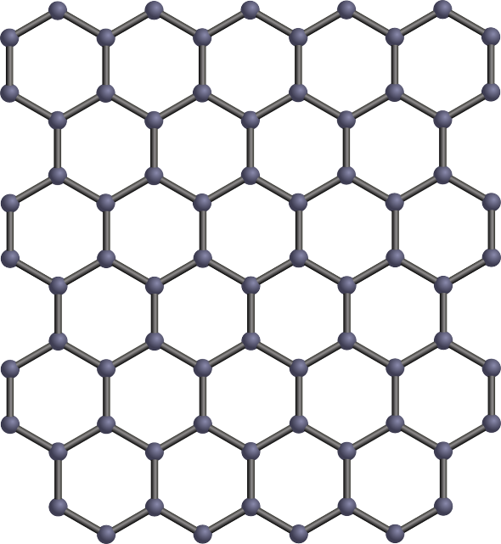












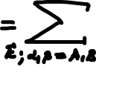
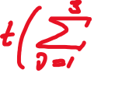




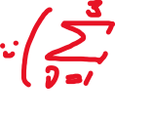




Graphene (honeycomb lattice) model

Slide 34
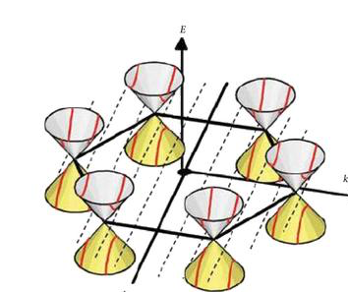


















Graphene band structure
Band structure near Dirac cones

Slide 35













Symmetries of graphene
Inversion symmetry A sublattice B sublattice
Time-reversal symmetry
“Weak” “chiral” symmetry (easily broken by longer range hoppings)
Breaking “chiral” symmetry can move Dirac nodes around BZ, but can’t destroy them due to PT-symmetry

Slide 36












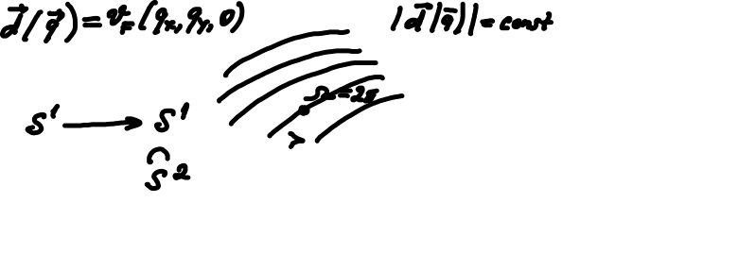





Berry phase “protection” of the Dirac points

Slide 37
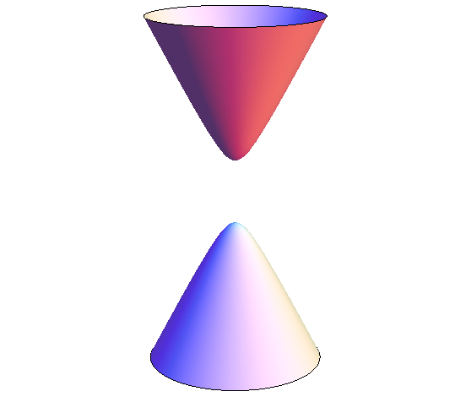











Three ways to open the gap at the Dirac points
Break inversion symmetry (trivial insulator, e.g. Boron nitride)
Break time reversal symmetry (Haldane model, quantum Hall, Nobel 2016)
Keep P and T, but introduce a spin dependent mass (Kane & Mele, topological insulator, Nobel 20??)

Slide 38
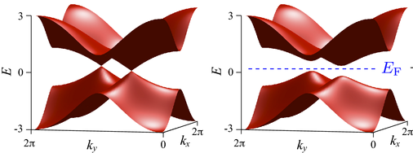














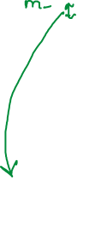





Topological index (example of a trivial insulator)

Slide 39









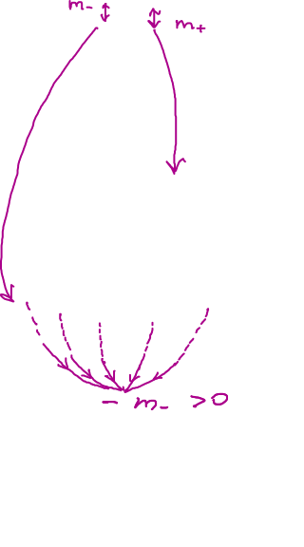








Topological index (example of a Chern insulator)

Slide 40
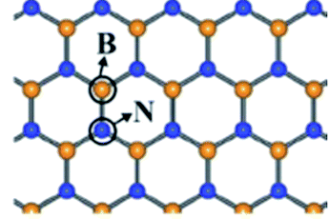
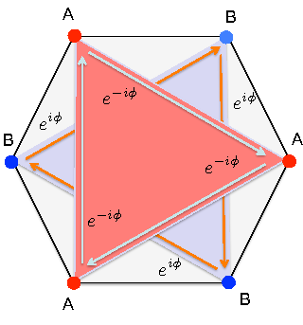
Realizations and “realizations” of the two phases
Trivial insulator (Chern number, C=0) Boron nitride
Chern insulator (C=1): Haldane model (does not occur naturally)

Slide 41




Domain wall
topological insulator (x<0)
-K
trivial
insulator (x>0)
boundary
(domain wall)
$$m_{−}>0$$
$$m_{+}>0$$
K
$$m_{−}>0$$
-K
band
inversion
x
$$m_{+}<0$$
K

Slide 42



Dispersing Jackiw-Rebbi-like edge modes
y
$$m_{+}>0$$
$$m_{+}<0$$
$$ℋ_{+}=v_{F}\left(−i{\hat{σ}}_{x}∂_{x}+i{\hat{σ}}_{y}k_{y}\right)+m_{+}\left(x\right){\hat{σ}}_{z}$$
Fixing $k_{y}$ maps the problem on the 1D Jackiw-Rebbi model, with the edge mode
|$\left.ψ\left(k_{y}\right)\right\rangle =e^{ik_{y}y} \exp\left[−\frac{1}{v_{F}}\int_{−∞}^{x}{|m_{+}\left(x^{′}\right)|dx′}\right]\text{|}\left.χ_{+}\right\rangle$
$$ℋ_{+}\text{|}\left.ψ\left(k_{y}\right)\right\rangle =v_{F}k_{y}\text{|}\left.ψ\left(k_{y}\right)\right\rangle$$

Slide 43
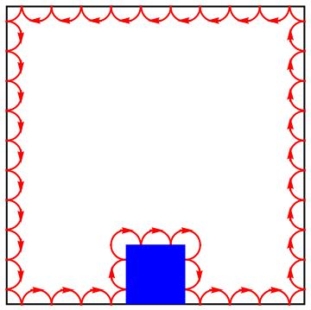
Properties of the chiral edge mode
|$\left.ψ\left(k_{y}\right)\right\rangle =e^{ik_{y}y} \exp\left[−\frac{1}{v_{F}}\int_{−∞}^{x}{|m_{+}\left(x^{′}\right)|dx′}\right]\text{|}\left.χ_{+}\right\rangle$
Conducting chiral edge
(half of a 1D quantum wire)
The chiral mode can not be stopped by any obstacle or edge disorder.
Normally, any 1D system localizes at low temperature (Anderson insulator). The chiral edge is protected from localization.
Such a 1D mode can not appear in a pure 1D system, only at a boundary of a higher-dimensional system.
The chiral edge carries the quantized Hall conductivity (IQHE).
σ _{xy}=j _{x}/E _{y}= n e²/h

Slide 44
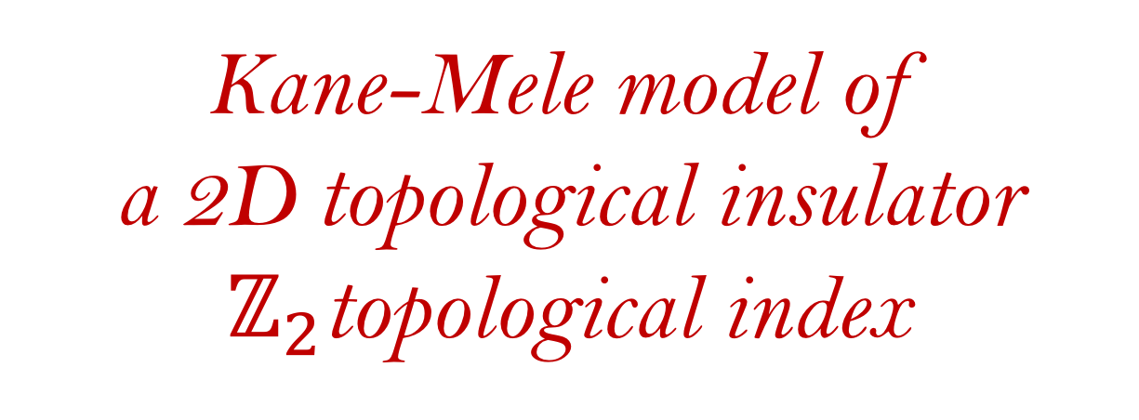
Kane-Mele model of
a 2D topological insulator
$ℤ_{2}$topological index

Slide 45
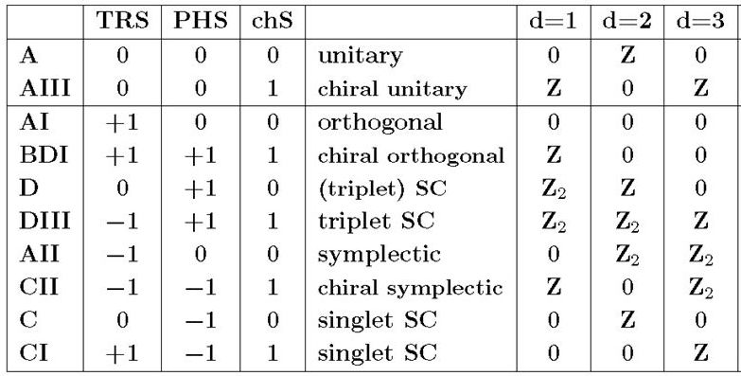
Reviewing some entries of the topological table
1D insulators w/o symmetry are
trivial because any loop on a
sphere is contractible
Quantum Hall
(e.g., Haldane model)
SSH model
2D topological insulator
(Kane-Mele, BHZ: this lecture)
3D topological insulator
(this lecture)
Majorana wire
Topological superconducting films
(e.g, px+ipy like strontium ruthenate)

Slide 46
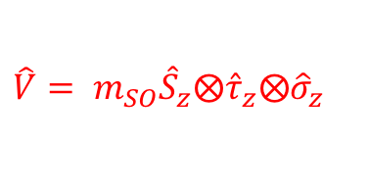



Destroying Dirac points in spinfull graphene
Complicated-looking graphene Hamiltonian with spin & valley indices restored
$ℋ=v_{F}\left(\hat{𝕀}⨂{\hat{τ}}_{z}⨂{\hat{σ}}_{x} q_{x}+\hat{𝕀}⨂\hat{𝕀}⨂{\hat{σ}}_{y}{ q}_{y}\right)$ + $\hat{V}$
Spin Valleys (K & K’) Sublattices (A & B)
gap-opening perturbation
Inversion (P-) breaking perturbation (trivial insulator, e.g. Boron nitride)
T-reversal breaking perturbation (Chern insulator, e.g. Haldane model)
Symmetry preserving perturbation (topological insulator, Kane-Mele model)
$$\hat{V}= m_{p}\hat{𝕀}⨂\hat{𝕀}⨂{\hat{σ}}_{z}$$
$$\hat{V}= m_{T}\hat{𝕀}⨂{\hat{τ}}_{z}⨂{\hat{σ}}_{z}$$
$$\hat{V}= m_{SO}{\hat{S}}_{z}⨂{\hat{τ}}_{z}⨂{\hat{σ}}_{z}$$

Slide 47






The simplest construction
Kane-Mele model = Haldane model$l^{2}$
spin up
spin down
$$m_{−}<0$$
$$m_{+}>0$$
$$m_{−}>0$$
$$m_{+}<0$$
K’
K
K’
K
$${\breve{ℋ}}_{Kane−Mele}=\left(\begin{matrix}{\hat{ℋ}}_{Haldane} & 0 \\ 0 & {\hat{ℋ}}_{Haldane}^{∗}\end{matrix}\right)$$
E=0

Slide 48


Can the degeneracy be lifted?
Other spin-orbit couplings are possible (e.g., Rashba), which introduce off-diagonal terms and break spin conservation (no notion of spin up or down exists)
$$\left(\begin{matrix}{\hat{ℋ}}_{Haldane} & 0 \\ 0 & {\hat{ℋ}}_{Haldane}^{∗}\end{matrix}\right)$$
$$\left(\begin{matrix}{\hat{ℋ}}_{Haldane} & \# \\ \# & {\hat{ℋ}}_{Haldane}^{∗}\end{matrix}\right)$$
Can the generic spin-orbit perturbation lift the degeneracy?
?
NO!
E=0

Slide 49






The degeneracy is protected by T-reversal symmetry
Time-reversal operator = spin-rotation and complex conjugation
$𝕋 \left(\begin{matrix}ψ_{↑} \\ ψ_{↓}\end{matrix}\right)=e^{iπ{\hat{S}}_{y}}{\left(\begin{matrix}ψ_{↑} \\ ψ_{↓}\end{matrix}\right)}^{∗}=\left(\begin{matrix}ψ_{↓}^{∗} \\ {−ψ}_{↑}^{∗}\end{matrix}\right)$,$𝕋^{2}=−1$
Time-reversal symmetry implies $\left[ℋ,𝕋\right]$=0
This guarantees double-degeneracy of the spectrum
$ℋ$|$\left.ψ_{E}\right\rangle =E\text{|}\left.ψ_{E}\right\rangle$ and $𝕋$|$\left.ψ_{E}\right\rangle =\text{c}\text{|}\left.ψ_{E}\right\rangle$
$$𝕋^{2}\text{|}\left.ψ_{E}\right\rangle =c^{∗}c\text{|}\left.ψ_{E}\right\rangle$$
This is a contradiction, because it requires ${|c|}^{2}=−1$
Hence, the must be (at least) 2 distinct, degenerate states with energy E connected by $𝕋$-reversal (Kramers doublet).
E=0
We can’t remove degeneracy at E=0, as long as perturbation does not break $𝕋$-reversal!

Slide 50









$ℤ_{2}$ classification of 2D topological insulators

Slide 52
Outline
Preliminaries of the topological band theory
Topological indices and boundary modes
Construction of the topological states and indices
  One dimension (symmetry and topology)
    Su-Schrieffer-Heeger model
    Jackiw-Rebbi zero modes
    Majorana chain
  Two dimensions
    Graphene
    Haldane model (Chern insulator)
    Kane-Mele model ($ℤ_{2}$classification)
  Three-dimensions
    Weak and strong topological insulators
    $ℤ_{2}$classification and Fu-Kane method
    Topological Kondo insulators
    Topology in time: Floquet systems

Slide 53
Destroying Dirac points in spinfull graphene
Complicated-looking graphene Hamiltonian with spin & valley indices restored
$ℋ=v_{F}\left(\hat{𝕀}⨂{\hat{τ}}_{z}⨂{\hat{σ}}_{x} q_{x}+\hat{𝕀}⨂\hat{𝕀}⨂{\hat{σ}}_{y}{ q}_{y}\right)$ + $\hat{V}$
Spin Valleys (K & K’) Sublattices (A & B)
gap-opening perturbation
Inversion (P-) breaking perturbation (trivial insulator, e.g. Boron nitride)
T-reversal breaking perturbation (Chern insulator, e.g. Haldane model)
Symmetry preserving perturbation (topological insulator, Kane-Mele model)
$$\hat{V}= m_{p}\hat{𝕀}⨂\hat{𝕀}⨂{\hat{σ}}_{z}$$
$$\hat{V}= m_{T}\hat{𝕀}⨂{\hat{τ}}_{z}⨂{\hat{σ}}_{z}$$
$$\hat{V}= m_{SO}{\hat{S}}_{z}⨂{\hat{τ}}_{z}⨂{\hat{σ}}_{z}$$

Slide 54
Reviewing some entries of the topological table
1D insulators w/o symmetry are
trivial
Quantum Hall
(e.g., Haldane model, previous lecture)
SSH model
2D topological insulator
(Kane-Mele, BHZ: this lecture)
3D topological insulator
(this lecture)
Majorana wire
B-phase of superfluid
helium-3
Topological superconducting films
(e.g, px+ipy like strontium ruthenate)

Slide 55
CdTe/HgTe heterostructures
and BHZ model
(briefly, one more time)

Slide 56


CdTe
X
HgTe
CdTe
Bernevig, Hughes, Zhang (2006)
Koenig,.., Molenkamp.., Zhang (2007)
Pankratov, Pakhomov, & Volkov. "Supersymmetry in heterojunctions: Band-inverting contact
on the basis of Pb1-xSnxTe and Hg1-xCdxTe". Solid State Communications 61 (2): 93 (1987)
Notes:
56

Slide 57





Slide 58









First observed topological insulator: HgTe
HgTe dispersion (per spin): Dirac cone with small band gap
Notes:
Here’s the time for the topological crash course – picking up the mantle from Mark Rudner, the band structure of HgTe for spin up, takes the form of a vector d dot the pauli matrices which I write as tau. D is a function of momentum space, its x and y components are px and py, but it also has a z component – gap m with an extra contribution – b p^2. if b and m have the same sign, the phase is trivial, and the dispersion looks like this. If the relative sign is negative, a miracle happens, this becomes a topo-ins and how does the dispersion of this miracle looks? Essentially the same. Except – once you put an edge in the system, an edge state dispersion appears. Single quantu mchannel per spin.

Slide 59






Notes:
Clearly this miracle is a bit subtle. To explain it I reacquainted myself with the mathematica graphing functions. The way we see the miracle, is we convert d into a unit vector. The number of edge states, and therefore sigma xy is determined from the Chern invariant of this n over the BZ. This integral basically asks – how much of the unit sphere does n hat cover? Her is how it goes. Lets start covering the BZ from the p=0 point, where n is pointing to the nrth pole, andat the same time of marking the BZ area, we mark the area on the n sphere that n covers- in this case, the snow cap near the north pole.

Slide 60



Notes:
Clearly this miracle is a bit subtle. To explain it I reacquainted myself with the mathematica graphing functions. The way we see the miracle, is we convert d into a unit vector. The number of edge states, and therefore sigma xy is determined from the Chern invariant of this n over the BZ. This integral basically asks – how much of the unit sphere does n hat cover? Her is how it goes. Lets start covering the BZ from the p=0 point, where n is pointing to the nrth pole, andat the same time of marking the BZ area, we mark the area on the n sphere that n covers- in this case, the snow cap near the north pole.

Slide 61


Notes:
Going out, more of the sphere is covered.

Slide 62




Notes:
More out – the n’s on larger values get dominated by the b p squared, and they return to the north pole, losing ground.

Slide 63



Slide 64


Notes:
And as we reach the far end of the BZ we see that all ground gained is lost, and the unit sphere is completely uncovered.

Slide 66



Slide 67



Slide 69



Slide 70



Slide 71



Slide 72
Three dimensions

Slide 73

High-symmetry planes
3D TI can only exist with T-symmetry
Brillouin zone of a 3D lattice
A constant kz plane can be considered as a 2D system
Most of these planes are NOT invariant under the time-reversal transformation, because time-reversal changes kz to –kz.
However, there are 2 special planes kz=0 and π
For the kz=0 plane and the kz=π plane, we can consider them as two 2D systems and they are invariant under time-reversal.
For a 2D system with T-symmetry, we know that there are two types of insulator: trivial and quantum spin Hall.
Hasan and Kane, RMP (2010).
Qi and Zhang, RMP (2011).

Slide 74
Trivial 3D insulator
3D TI can only exist with T-symmetry
Brillouin zone of a 3D lattice
Case I: both are topologically trivial
The system is a trivial 3D insulator

Slide 75


Weak topological insulator
3D TI can only exist with T-symmetry
Brillouin zone of a 3D lattice
Case II: both are topologically nontrivial (QSH)
Weak topological insulator
Stack of 2D QSH insulators
Surface state has open Fermi surfaces.
There are 3 types of weak TIs (stacking along x, y and z).

Slide 76


Strong topological insulator
3D TI can only exist with T-symmetry
Brillouin zone of a 3D lattice
Case III: one topologically nontrivial (QSH) and the other one is trivial
Strong topological insulator
Surface state has odd number of Fermi surfaces
Spin has a helical structure around the Fermi surfaces.

Slide 77


$ℤ_{2}$ classification of 3D topological insulator
3D TI can only exist with T-symmetry
Brillouin zone of a 3D lattice
A more refined classification includes three weak indices and one strong index:
$${(ℤ}_{2}×ℤ_{2}×ℤ_{2})×ℤ_{2}$$

Slide 78






Fu-Kane method for inversion-symmetric systems

Slide 79

ARPES data in Bi-based topological insulators
Topological chiral states were directly visualized in ARPES experiments (Zahid Hasan group)
Bi₂Se₃, Bi₂Te₃, Bi_{1-x}Sb_{x}
Hsieh et al., Nature 452, 970 (2008),
Xia et al., Nature Phys. 5, 398 (2009),
Zhang et al., Nature Phys. 5, 438 (2009),
Chen et al., Science 325, 178 (2009),
many more…

Slide 80


Problem: Most topological “insulators”
like Bi₂Se₃ are not actually insulators ☹
N. Butch et al. (Paglione group, Maryland)

Slide 81



Slide 82





Max Dzero (Kent State)
Kai Sun (U. of Michigan)
Piers Coleman (Rutgers)

Slide 83



Kondo TIs: recent resolution of an old mystery
SmB₆
Ideal
Topological
Insulator!
Paglione lab
Below 5K, conductivity saturates
to a value incompatible (<<) with
metallic or activated hopping conductivity.
(Almost) standard insulating behavior, as $T→0.$
Metal
J. W. Allen, B. Batlogg and P. Wachter, Phys. Rev. B 20, 4807(1979).

Slide 84


Heavy fermion materials in a nutshell
Experimental signature:
  Fermi liquid with a very large effect electron mass
Theoretical description:
  Electrons moving on a lattice of local spins
Yazdani lab

Slide 85

Prototypical Kondo insulator: Samarium hexaboride
Hybridization-induced Topological (Kondo) insulator
SmB₆

Slide 86



Anderson model of a Kondo insulator
An important property of the form-factor: since it mixes up states with
different parities, it must vanish at the high-symmetry points in the BZ.

Slide 87


Mean-field “solution” of the Anderson model
A very sophisticated theory (slave bosons, gauge fields, etc.)

Slide 88




Mean-field Hamiltonian

Slide 89




Kondo insulators and semimetals

Slide 90






Kondo insulators and semimetals

Slide 91






Inversion-symmetric Kondo insulator

Slide 92


Topological invariant of a tight-binding KI
Refs: Dzero et al., “Topological Kondo Insulators,” Phys. Rev. Lett. 104, 106408 (2010)
Dzero et al.,“A theory of Topological Kondo Insulators,” Phys. Rev. B 85, 045130 (2012)
Alexandrov et al. considered a more realistic band structure in Phys. Rev. Lett. 111, 226403, (2013)
Notes:
v= is the valence of the Samarium ion. In SmB6 v=3-nf while nf measures the number of f-holes in the filled 4f6 state, so that nf= 1 corresponds to the 4f5 configuration.

Slide 93

RECENT EXPERIMENTS (INCOMPLETE LIST)
E. Reich, “Hopes surface for exotic insulator,” Nature 492, 165 (Dec 2012)
M. Neupane et al., “Surface electronic structure of the topological Kondo insulator candidate correlated electron system SmB6,” Nature Comm. 4, 2991 (2013)
X. Zhang et al., “Hybridization, Inter-Ion Correlation, and Surface States in the Kondo Insulator SmB6,” Phys. Rev. X 3, 011011 (2013)
M. Hatnean et al., “Large, high quality single-crystals of the new Topological Kondo Insulator, SmB6,” Nature Scientific Rep. 3, 3071 (2013)
S. Suga et al., “Spin-Polarized Angle-Resolved Photoelectron Spectroscopy of the So-Predicted Kondo Topological Insulator SmB6,” J. Phys. Soc. Jpn. 83, 014705 (2014)
J. Jiang et al., “Observation of possible topological in-gap surface states in the Kondo insulator SmB₆ by photoemission,” Nature Comm. 4, 3010 (2013)
D. J. Kim, J. Xia, and Z. Fisk, “Topological surface state in the Kondo insulator samarium hexaboride,” Nature Materials 13, 466 (2014)

Slide 94





One-slide summary of experiments
Geometry-dependent transport Weak antilocalization (Irvine) Quan. oscillations (Michigan)
Notes:
v= is the valence of the Samarium ion. In SmB6 v=3-nf while nf measures the number of f-holes in the filled 4f6 state, so that nf= 1 corresponds to the 4f5 configuration.

Slide 95
Details of
some recent experiments
1. Simplest proof of surface conduction

Slide 96




What is geometry dependence of the resistance for a normal 3D conductor?

Slide 97
SmB₆ thickness dependence study (Greene & Paglione)
Thickness
So, it can NOT be conventional 3D conduction. But what is it? How to prove it’s a surface?

Slide 98





Test for surface conduction
Following, a “theory” paper by Barua and Rajeev arXiv:1304.4037 entitled “Many Topological
Insulators Fail the Surface Conduction Test” pointed out by Rick Greene.
Surface and bulk channels are connected in parallel
Connection to resistivities
Total resistance with geometry dependent factors
If at room T the conduction is through the bulk and at low T, through the surface, we have

Slide 99
SmB₆ thickness dependence study (Greene & Paglione)
So, it is definitely surface transport! And the proof is reliable because of its simplicity.

Slide 100
Details of
some recent experiments
2. Surface Dirac bands
(ARPES and quantum oscillations)

Slide 101



Band structure of SmB₆ (LDA+Gutzwiller theory)
Hybridization between the localized f-bands and dispersive d-bands is the strongest near the X-points. This projects onto 3 Dirac cones on the surface.

Slide 102


Surface bands seen by ARPES
T<10K

Slide 103



Evidence for Dirac bands
The large-field asymptote of the “effective Landau level” intersects at
n=-1/2, which is consistent with the Fermi surface encircling a Dirac point.

Slide 104
Details of
some recent experiments
3. Chirality of the surface states
(anti-localization)

Slide 105




Weak localization physics in a nutshell
Probability to propagate from point 1 to point 2
Quantum
corrections
1
2
Classical
Conductance
Drude (1900)
Nature of the quantum correction
For self-crossing trajectories, , and a correction survives (weak localization)
Notes:
V~c/100

Slide 106

Weak anti-localization in spin-momentum locked systems
Spin-1/2, when rotated by 360 degrees,
picks up a minus sign. So, localization
becomes anti-localization, if spin and
momentum are locked.
Magnetic field suppresses anti-localization, hence, positive magneto-resistance. It is a well
known effect, quantitatively described by the Hikami-Larkin-Nagaoka formula:
In the ideal world, 2 would be a number of independent conducting channels.

Slide 107

SmB₆ weak anti-localization (Xia-Fisk data, UCIrvine)

