Slide 1
Chaos is cheap: adventures in nanomaterials synthesis
Sheryl Ehrman
Chemical and Biomolecular Engineering
University of Maryland, College Park
US Food and Drug Administration, April 16, 2015

Slide 2
Outline
Chemical and Biomolecular Engineering at the University of Maryland
Overview of aerosol synthesis
Flame and solution CuO based photoactive nanoparticle materials
Concerns about environmental health and safety of nanoparticle based materials
Summary and outlook

Slide 3
ChBE at the University of Maryland

Slide 4
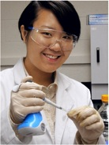
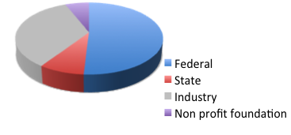
ChBE by the numbers
15 faculty, 2 assistant, 5 associate, 8 full professors
~ 340 undergraduate students with emphasis on undergraduate research experience
44 PhD, 18 MS students
~ 3 M external research expenditures FY 2013
CHBE Strengths: scholarly, entrepreneurial, diverse

Slide 5
ChBE research interests
Transport phenomena, multiphase flow and process intensification
Processing of advanced materials for catalysis, energy conversion and energy storage applications
Biomolecular engineering
Systems engineering

Slide 6
Current projects in the Ehrman laboratory
Aerosol synthesis of
  Lithium based oxide nanoparticles for battery cathode applications, collaboration with CS Wang, UMD
  Metal microparticles for printed electronics applications, collaboration with HD Glicksman, DuPont
Emissions and chemical transport modeling to support regional air quality improvement, collaboration with R. Dickerson, T. Canty, J. Stehr, UMD
Characterization of exhaled breath aerosols and respiratory protection, with applications to flu transmission, collaboration with D. Milton, UMD, Matthew Myers, Prasana Hariharan, Suvajyoti Guha, FDA

Slide 7
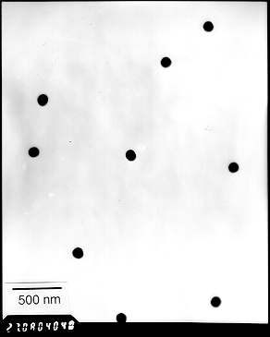
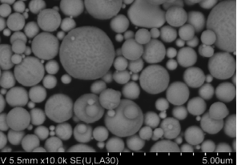

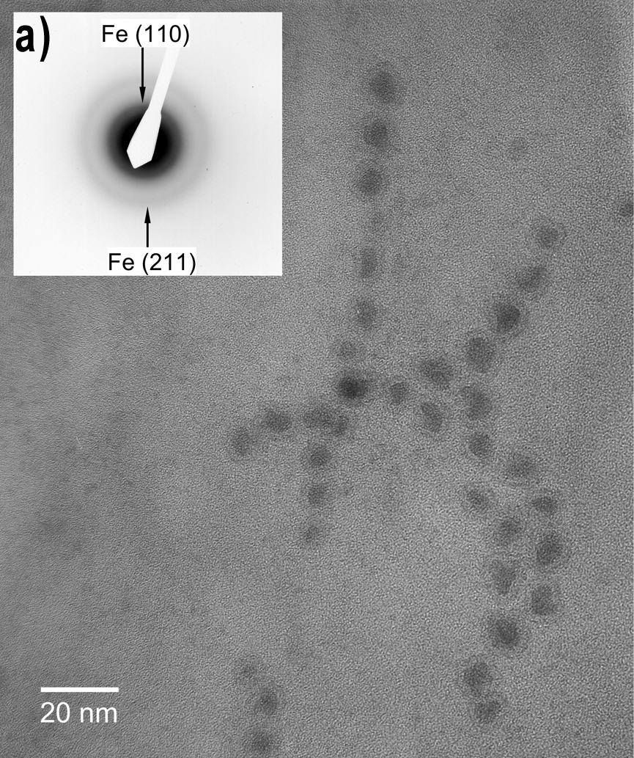
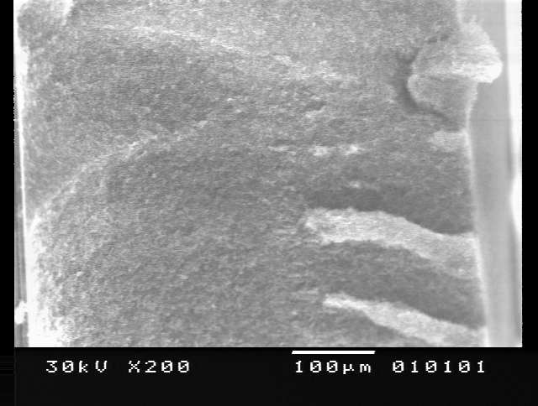
What are nanoparticles and where are they found?
Silver copper microparticles
500 nm
Size selected Cu nps
http://farm4.static.flickr.com/3453/3276124739_e62fed7954.jpg
Fe nps
Side view of film of TiO₂ nps
10⁻¹⁰ 10⁻⁹ 10⁻⁸ 10⁻⁷ 10⁻⁶ 10⁻⁵ 10⁻⁴ 10⁻³ 10⁻² 10⁻² 10⁻¹ 1 10 100 1000
meters
Notes:
Benzene - ~ .7 nm, Nanometer to centimeter, wet or dry, AIChE Particle Technology Forum

Slide 8
Example material: iron oxide
B
Size (< 10 nm) one magnetic domain per particle, superparamagnetic nanoparticles
MRI - positive (taken up by tissue of interest) or negative (not taken up) contrast
Many products in clinical use
Becomes part of normal iron load in body
More selective active targeting via surface modification an active area of research
Notes:
T2 relaxation time shortening, caused by inhomogenaities in field around the particles. Feridex, IV taken up by healthy reticuloendothelial liver cells, allowing better view of tumors; Gastromark, oral, taken up in intestines, to allow better view of pancreas and other things near intestines

Slide 9
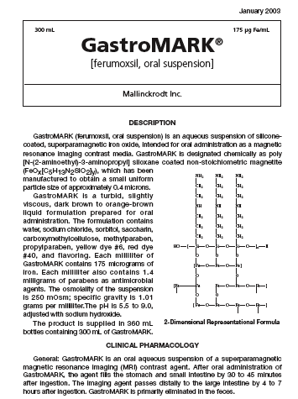
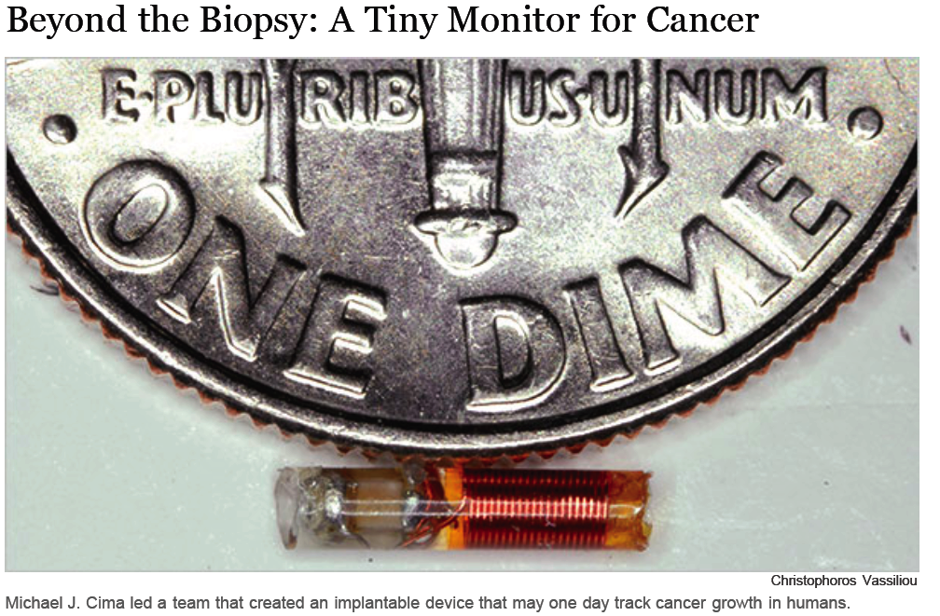
Example products/future products
T2 Biosystems, US
http://www.nytimes.com/2009/08/30/business/30novel.html?_r=1&scp=1&sq=t2%20biosystems&st=cse
http://www.amagpharma.com/documents/products/pdfs/gastromark_insert.pdf

Slide 10

Nanoproducts, consumer
  ©D. Hawxshurst/Wilson Center
  Safe handling of nanotechnology, Nature 444, 267-269 (16 November 2006)
  *http://www.nanotechproject.org/inventories/consumer/analysis_draft/

Slide 11
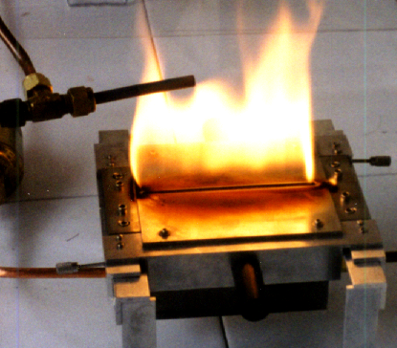
Methods of making nanoparticles
Starting from molecular level
  From precursor
  Aerosol
    Combustion synthesis
    Thermal or plasma synthesis
  Solution phase synthesis
    Precipitation
    Sol gel
    Emulsion
  Evaporation/condensation
Starting from cluster level
  Spray pyrolysis
  Electrospray

Slide 12
Nanoparticle engineering
Synthesis
Porosity, disperse/cohesive, retention or change of properties as synthesized…
Processing
Size
Shape
Crystallinity
Surface chemistry
Magneto, electro, optical properties…
System:
functionality
performance
Energy conversion efficiency
Catalytic performance
Sensor response
Rheological behavior…
Notes:
Micro or nanoparticles part of a system which has functionality
Particle properties determine functionality
Processing, post processing modification determine properties

Slide 13
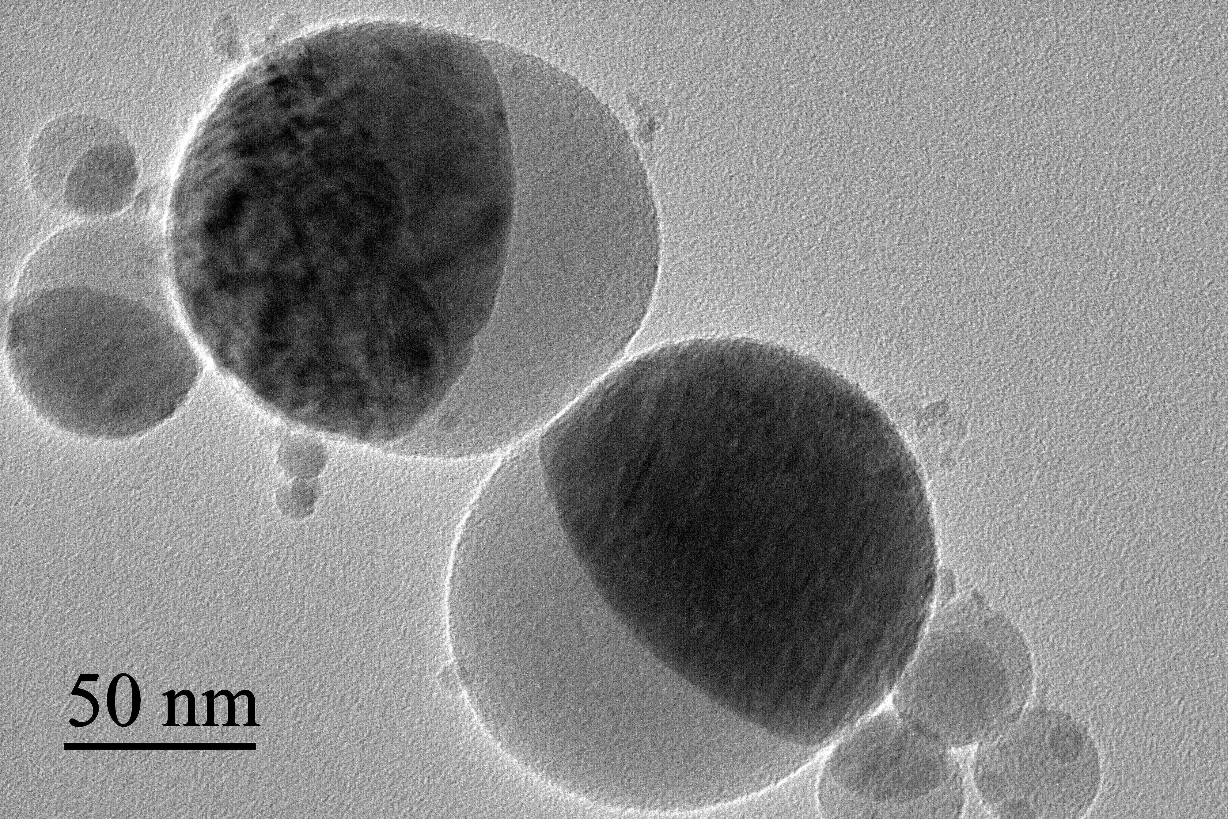
Pros and cons
Limited size control
Poor control of aggregation, especially gas to particle conversion
May battle thermodynamics in mixed systems
Rapid
Simple, less steps required
Product dry, no solvents
Amenable to continuous processing
May be scalable
iron oxide/
silica

Slide 14
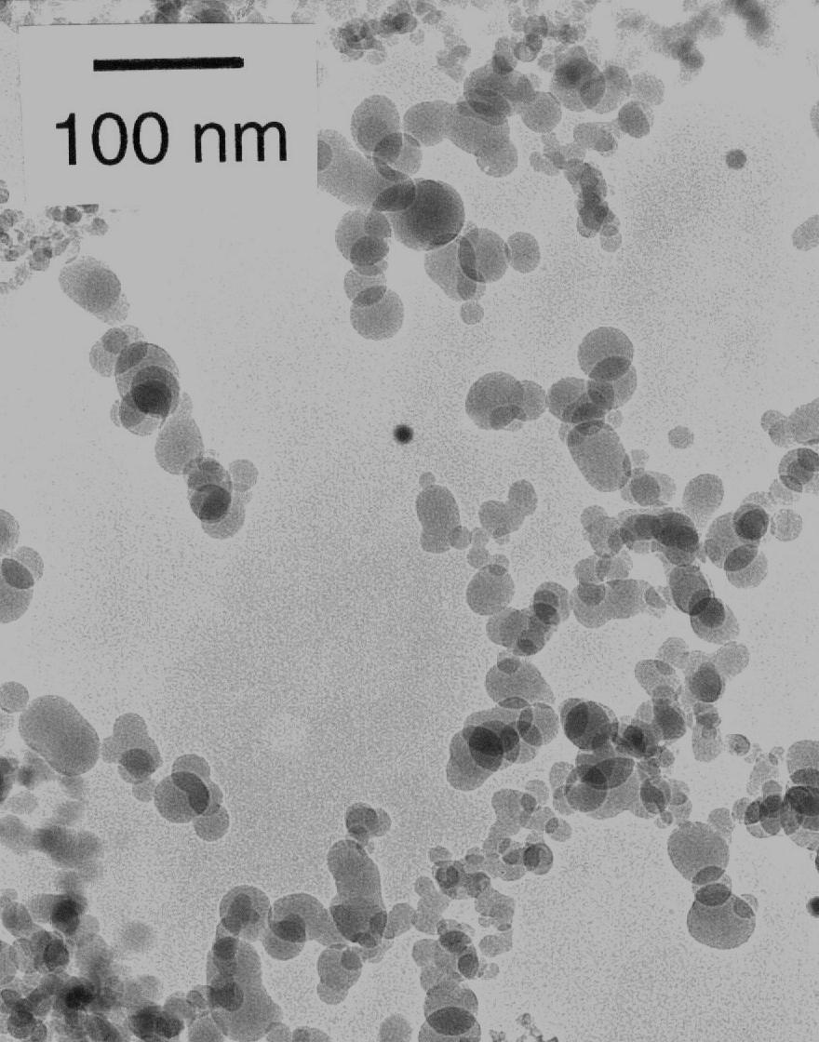
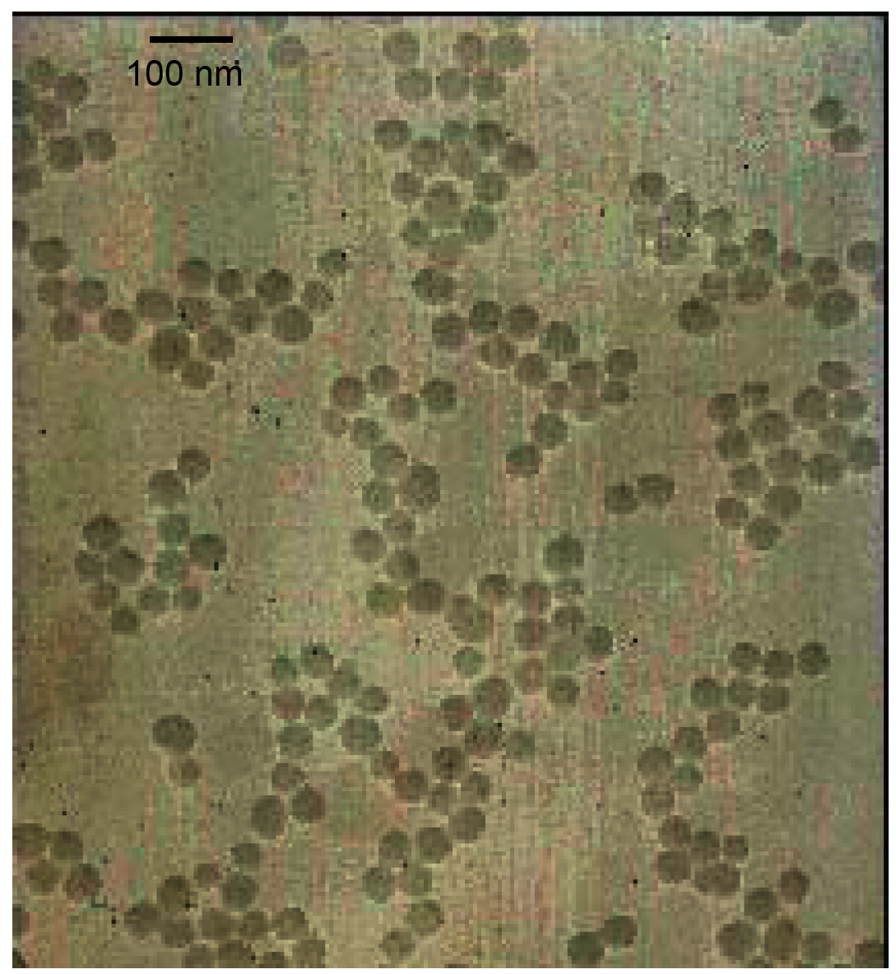
Chaos is cheap, any proof?
Fumed silica from our lab,
not for sale
Colloidal silica (stöber synthesis)
from our lab, not for sale
From alibaba.com
Colloidal silica (30%) $600-$1000/metric ton
Fumed silica (dry) as low
as $130/metric ton

Slide 15
Aerosol manufacturing, $$
Product | Volume, tons/yr | Market $/yr | Process
Carbon black | 8 M | 8 B | Flame
Titania | 2 M | 4 B | Flame
Fumed silica | 0.2 M | 2 B | Flame
Zinc oxide | 0.6 M | 0.7 B | Hot wall furnace
Fe, Pt, CeO₂ | 0.02 M | 0.3 B | Hot wall furnace, spray pyrolysis
Ref: K. Wegner, S.E. Pratsinis, Chem. Eng. Sci. 51, 4581 (2003)

Slide 16
Solar energy, the potential
http://www.nrel.gov/gis/images/map_pv_national_lo-res.jpg

Slide 17
17

Slide 18
Solar energy is intermittent
Storage of solar energy is key
Two approaches (of many):
Solar to electric to chemical energy
Photovoltaic (PV) + battery, supercapacitor, or…
Solar to chemical energy
Photoelectrochemical cells (PEC)
18

Slide 19
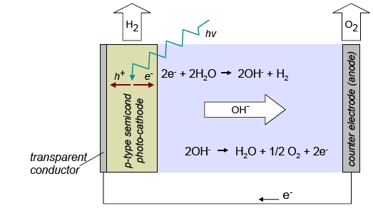
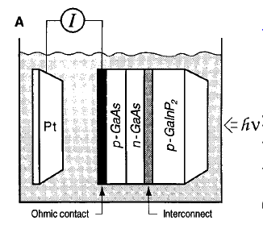
Perspective
State of the art: solar to chemical
12.4% efficiency
Khaselev and Turner, Science 280, 425 (1998)

Slide 20
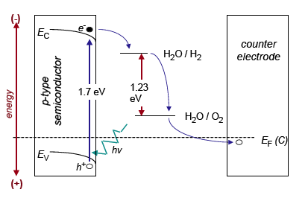
Perspective: materials constraints
Semiconductor band gap of at least 1.4 eV required because of polarization, but should still absorb in the visible range ( < 2 eV)
Long electron-hole pair lifetimes
Stability in electrolyte
Efficiency and cost

Slide 21
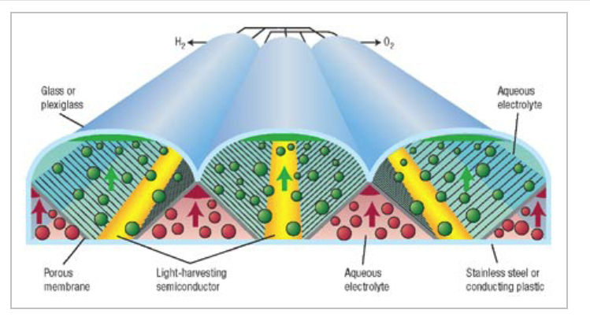
On a large scale, imagine….
J. Turner, Nature Materials, 7, 770-771 (2008)

Slide 22

H₂ as transportation fuel
January 2012
15 H₂ powered rickshaws
(Mahindra & Mahindra) deployed in New Delhi’s Pragati Maidan Exposition Center
A Yee, NY Times, Oct 1, 2012
The Hindu, 2 September, 2005
Bajaj Rickshaw Prototype
http://www.hinduonnet.com/2005/09/02/
stories/2005090204461400.htm

Slide 23
Perspective: life cycle
Efficiency
Cost

Slide 24
Approaches to materials optimization
Start with highest efficiency, try to reduce costs, here, combination photovoltaic/ PEC device, NREL, eff: 12.4 %
Or… start with inexpensive materials and try to improve efficiency
Materials of interest include CuO, ZnO, TiO₂
Khaselev and Turner, Science 280, 425 (1998)
Notes:
Research Needs for the Hydrogen Economy say that no matter how cheap the PV or PEC material is, a minimum of 10% efficiency is needed because of unavoidable baseline costs of other system components
Definition of efficiency? The efficiency of H2 production was calculated
with the following equation: efficiency
5 (power out)/(power in). The input
power is the incident light intensity of 1190
mW/cm2. For the output power, assuming
100% photocurrent electrolysis efficiency,
the H2 production photocurrent of 120 mA/
cm2 is multiplied by 1.23 V, which is the
ideal fuel cell limit at 25°C (the lower
heating value of hydrogen). Calculated by
this method, the H2 production efficiency
of our system is 12.4% (24).

Slide 25
Earth abundance
Atomic number, Z
http://pubs.usgs.gov/fs/2002/fs087-02/

Slide 26
Favorable band edge position
-2.0
ZnS
SiC
Cu₂O
-1.0
ZnO
SrTiO₃
GaP
CdS
KTaO₂
CdSe
Si
CuO
TiO₂
0
WO₃
MoS₂
Fe₂O₃
H⁺/H₂
V vs. NHE (pH=0)
1.0
O₂/H₂O
2.0
3.0
4.0
3.2
3.4
3.2
3.2
3.6
2.4
1.7
2.3
3.0
1.1
1.8
2.8
2.3
2.0
1.7
Band gap, eV
ZnO to Fe2O3 adapted from Navarro Y. et al., ChemSusChem. 2009; 2:471-485
Cu2O adapted from Gerischer H., Pure Appl. Chem 1980: 52: 2649-67
Notes:
Cu2O are adopted from Gerischer, 1978,
Gerischer H. Heterogeneous electrochemical systems for solar energy conversion. Pure Appl Chem. 1980;52:2649-67.
and CuO are adopted from Chiang et al., 2012d

Slide 27
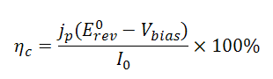
Conversion efficiency
η_{c} | : | Solar to hydrogen conversion efficiency (%)
I_{o} | : | Incident light intensity (W/m²)
j_{p} | : | Photocurrent density at a certain applied voltage (mA/cm²)
E⁰_{rev} | : | Standard water splitting reaction potential (1.23 V vs. NHE) at pH =0.0
V_{bias} | : | Applied external potential (V vs. RHE)

Slide 28
CuO systems to date, low efficiency
System | Light source | Incident power density (W/m²) | Photocurrent density (mA/cm²) | Solar to H2 efficiency (%) | Reference
CuO | 500W Xenon | 1000* | 0.08 | 0.06* | Nakaoka et al., 2004
CuO | 150W Xenon Arc | 8100** | 2.2 | 0.20** | Chauhan et al., 2006
2% Li-CuO | 150W Xenon Arc | 8100 | 0.44 | 0.05 | Koffyberg and Benko,1982
* Assume to be 1000 W/m²
** Assume to be 8100 W/m²

Slide 29
Photo - electro – chemical
light absorption
electron
separation
chemical
reaction
material with
small bandgap
material with
right band position
cell architecture
light
reflection
cell architecture

Slide 30
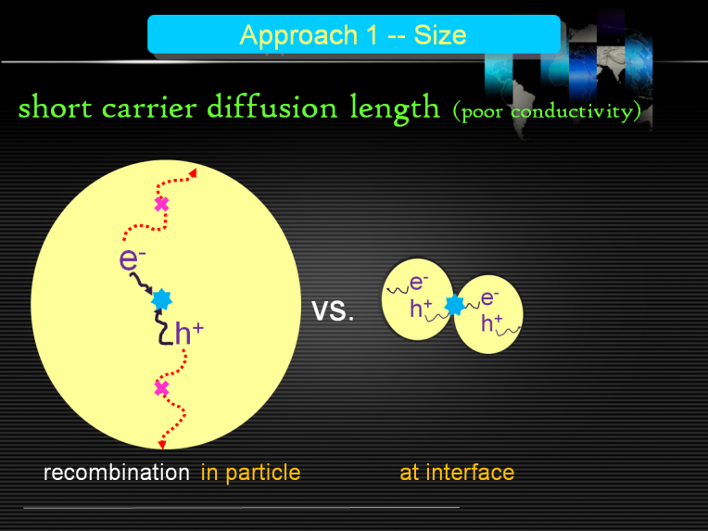
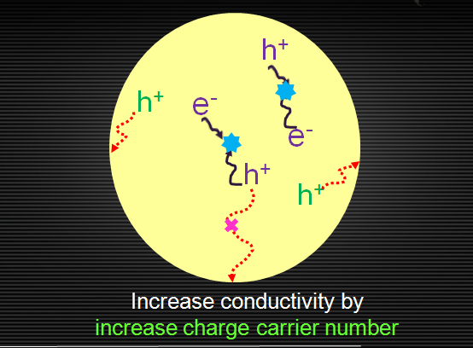
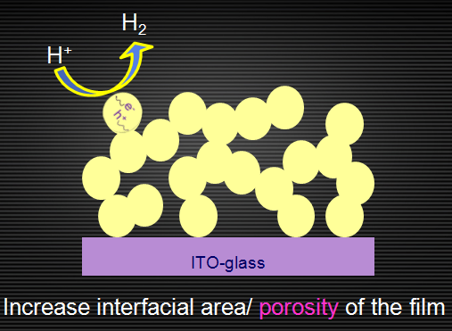
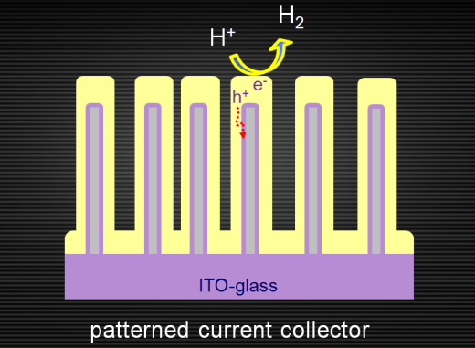
Efforts to improve performance
light absorption
electron
separation
chemical
reaction
light
reflection
(1)
(2)
(3)
(4)
Decrease particle size
Increase conductivity
Increase porosity
Shorten transport distance
Chiang et al., Int J H2 Energy, 2011
Chiang et al., J Electrochem Soc 2012
Chiang et al., Int J H2 Energy 2012b
Chiang et al., Nano Lett.
2012
Chiang et al., Int J H2 Energy, 2012a

Slide 31
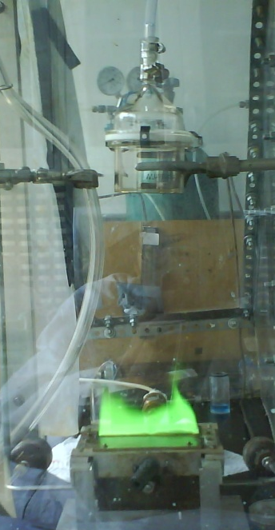
Flame spray pyrolysis
hood
Powder/ethanol solution spin coated to form porous films, followed by heat treatment
vacuum pump
collector
filter
particles
precursor : copper nitrate
flame + particles
nebulizer
compressed air
burner
stir

Slide 32
Processes occurring
single particles
chemical
reaction
collision
coalescence
condensation
aggregated
particles

Slide 33
Particle morphology
Single Particles
τ_{coalescence} < τ_{collision}
τ_{coalescence} > τ_{collision}
Agglomerated Particles
Ulrich (1970’s), Helble, Sarofim (80’s), Friedlander, Koch, Windeler, Lehtinen (90’s)…

Slide 34
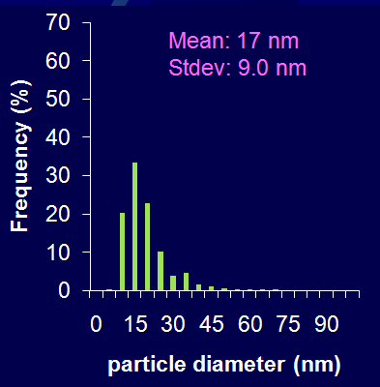
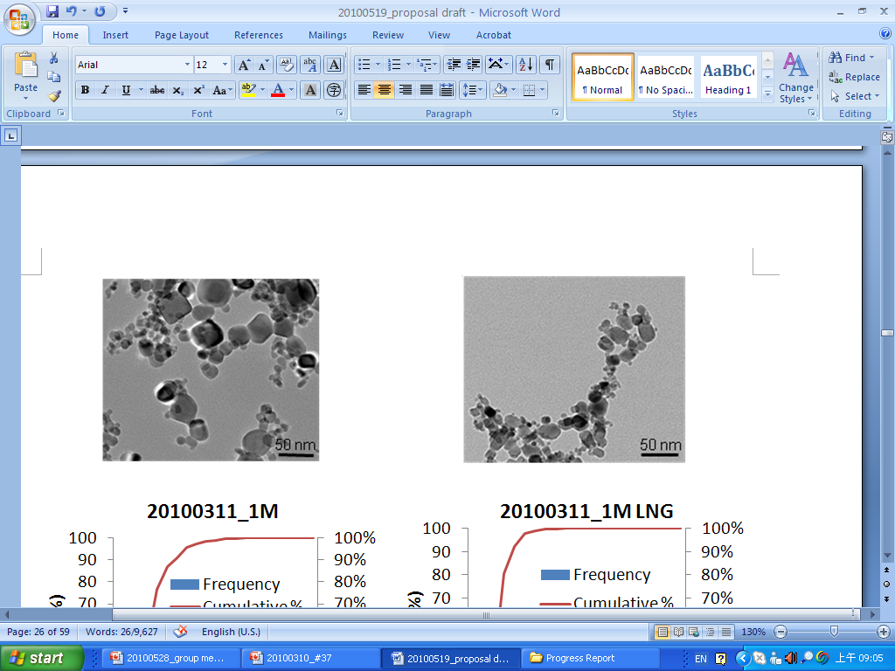
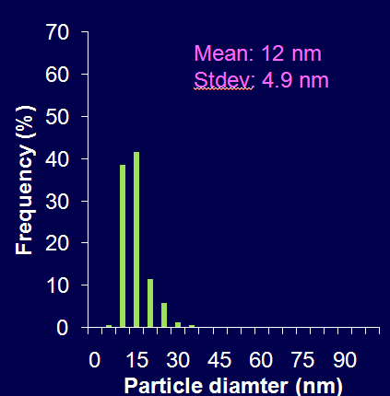
Control of particle size
w/o quenching
tunable angle
LNG
w/ quenching
movable position
burner
30% smaller
Notes:
34

Slide 35
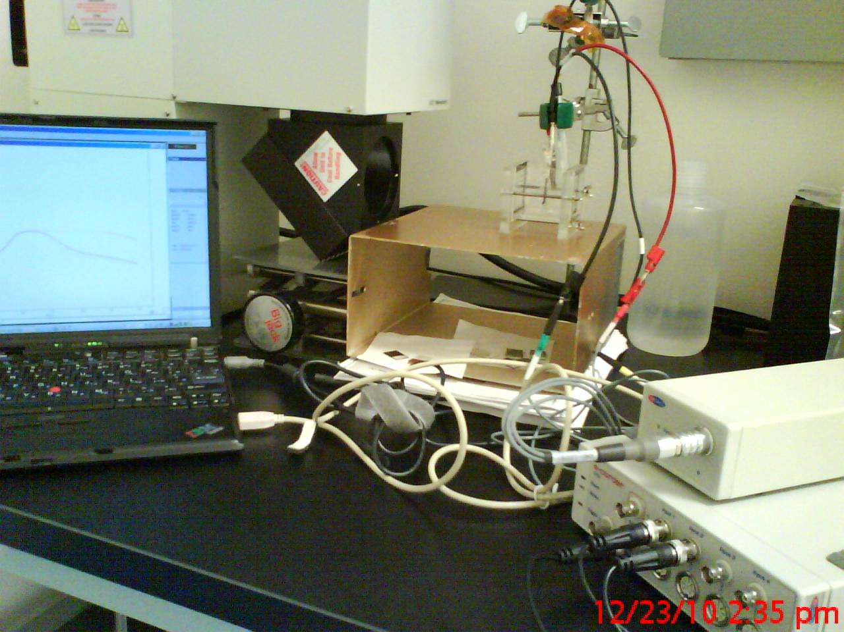
PEC test station
potentiostat
150 W Oriel solar simulator + full reflector beam turning mirror, AM1.5G filter, incident intensity = 1 sun (1000 W/m²)
A
V
Ag/
AgCl
CuO
Pt
visible light
H2
O2
1M KOH electrolyte, pH 14
Notes:
150 W full spectrum solar simulator (Oriel Instruments, USA), coupled with a full reflector beam turning mirror (Oriel Instruments, USA) and a AM1.5G filter with
a measured intensity of 1 sun (1000 W/m2) by a reference cell (Oriel instrument, USA)

Slide 36
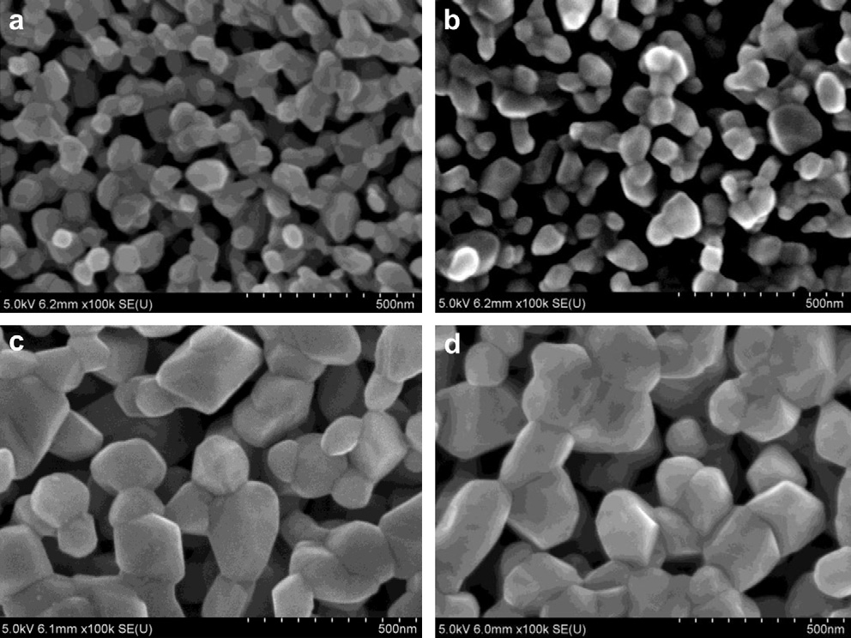
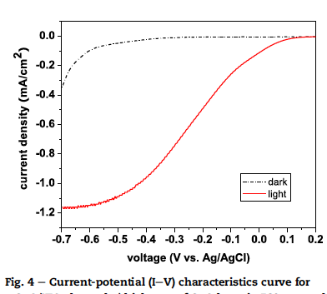
Post processing treatment optimized
Spin coated films made from powder/ethanol
Scanning electron micrographs of samples sintering at different temperature and period: (a) 450 C for 1 h, (b) 450 C
for 3 h, (c) 600 C for 1 h, (d) 600 C for 3 h.
Solar to H2 efficiency 0.3%
Chiang et al., Int J H2 Energy, 2011
Chiang et al., Int J H2 Energy, 2012a
Notes:
36

Slide 37
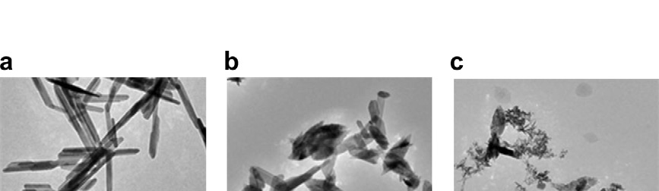
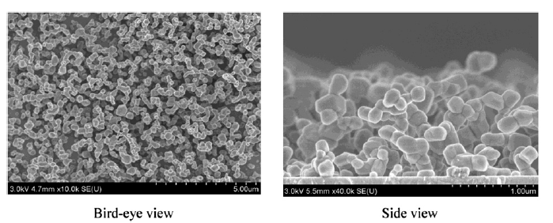
Precipitation route
copper nitrate + NaOH
Transmission electron micrographs of samples produced at (a) 25 C for 24 h, (b) 60 C for 45 min, (c) 95 C for 30 min
+ heat treatment 600 C,1 hour
Solar to H2 efficiency 0.7%
Chiang et al., Int J H2 Energy 2012b
Notes:
37

Slide 38
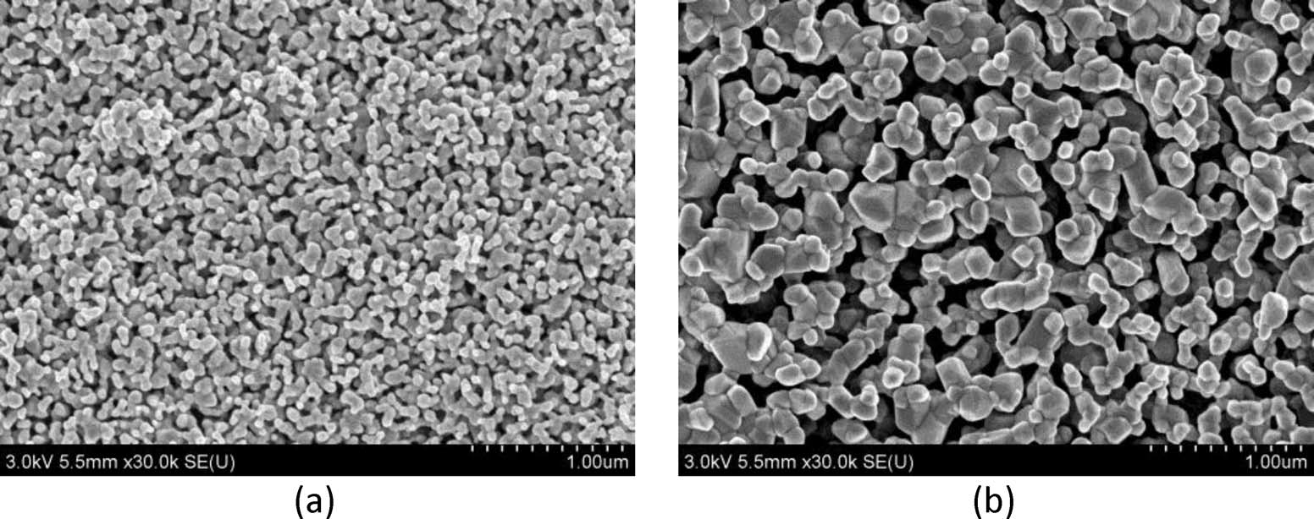
Addition of Li to improve conductivity
SEM images of 2 at % Li doped CuO sintered at (a) 450◦C for 1 hr and (b) 600◦C for 3 hr.
Conductivity CuO only: 2 x 10⁻⁶ to 4 x 10⁻⁶ S/cm
with 2% Li 7 x 10⁻⁵ to 3 x 10⁻⁴ S/cm
Solar to H2 efficiency 1.3 %
Aqueous solution of copper nitrate + lithium acetate
Chiang et al., J Electrochem Soc 2012
Notes:
Conductivity measured using electrical impedance spectroscopy
38

Slide 39
Additional structures
Polycrystalline
film
Polycrystalline nanorod
Single crystalline nanowire
Current collector + polycrystalline
3.2 % efficiency

Slide 40
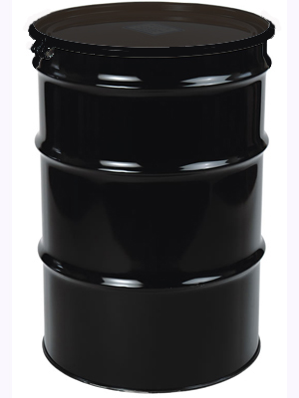
55 gallon drum of silicon tetrachloride vs fumed silica
silica
surface area = 1.6 m²
surface area = 2.4 x 10⁷ m²
assuming 300 m²/g
https://www.khlubes.com/images/55_gallon_drum.jpg

Slide 41
Potential risks associated with engineered nanomaterials
Exposure opportunities over the life cycle of the nanomaterial, intended, unintended
  Raw materials
  Manufacturing
  Use
  Disposal/reclamation

Slide 42
Routes for exposure, intentional or unintentional
Dermal
Gastrointestinal
Inhalation
Toxicity measurements in animals
LD50 = dose required to kill 50% of a population of test animals (mg/kg)
OSHA Permissible exposure limits (PELs) in humans, 8 h time weighted average (mg/m³)
Size of material considered in some cases,
ex: respirable quartz, but no separate standards for nanomaterials
Notes:
Dermal: resistance: Stratum corneum, keratinized dead skin cells and lipds
GI: uptake of neutrients by willi/micro villia in intestines
Lung : alveolar membrane/blood

Slide 43
MSDS info on titania, not nano
5 nm particles have 100 x
the surface area per gram
as 500 nm particles
Cas: 13463-67-7
RTECS #: XR2275000
Name: TITANIUM DIOXIDE. MOLECULAR FORMULA: TIO*2. MOLECULAR WEIGHT: 79.9.
OSHA PEL: 15 MG/M3
*PEL 8 hour time weighted permissible exposure limit
https://fscimage.fishersci.com/msds/23510.htm
~ 275 x EPA 24 h standard for 2.5 micron diameter or less particulate air pollution

Slide 44
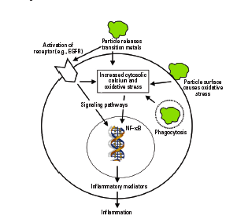
Primary pathways hypothesized at the cellular level
Particle surface/cell interactions cause oxidative stress, increased intercellular calcium and gene activation
Transition metals from NPs cause same
Cell surface receptors are activated by transition metals from NPS leading to gene activation
NP/mitochondria interactions cause oxidative stress
Figure in Oberdoerster et al., Environmental Health Perspectives, 113, 823-838 (2005)
Adapted from Donaldson and Tran Inhal. Toxicol. 14 5-27 (2002)
Notes:
Formation of free radicals, accumulation of peroxidative products, depletion of antioxidants

Slide 45
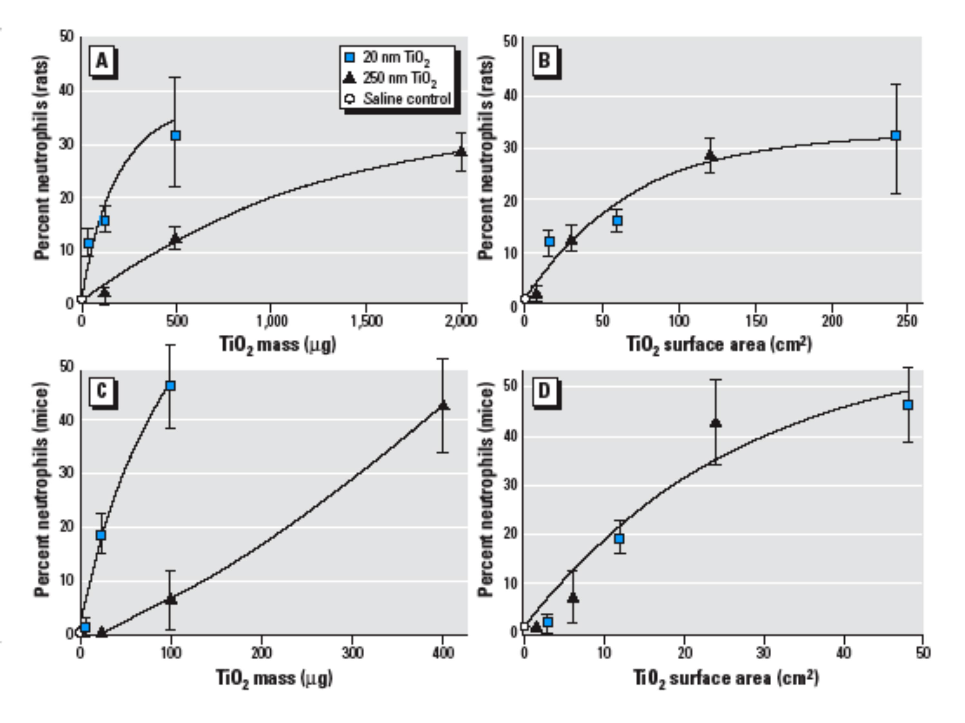
Response in rats and mice correlates well with surface area, for inhaled engineered NPs
Oberdörster G, Philos Trans R Soc Lond A 358(2000) 2719–2740
Oberdörster et al., Environ. Health Perspectives, 113 (2005) 823-839

Slide 46
Not just surface area
Free silanol group intensity
Pandurangi et al., Environ Health Perspect 86: 327-36 (1990)
Ability to catalyze reactive oxygen species formation in vitro
Limbach et al. Environ Sci Tech 41: 4158-4163 (2007)
…..
No generalized trends have emerged across all material systems
What about combinations of nanoparticles with other substances?

Slide 47
Real exposure scenarios - may not be single component
Other components physi- or chemisorbed to the engineered nanomaterial surface
  Nanoparticle based targeted therapeutics
  Consumer product formulations
  Accidental release of nanoparticles together with condensable or reactive species
  Nanoparticles modified by environment between release and exposure

Slide 48
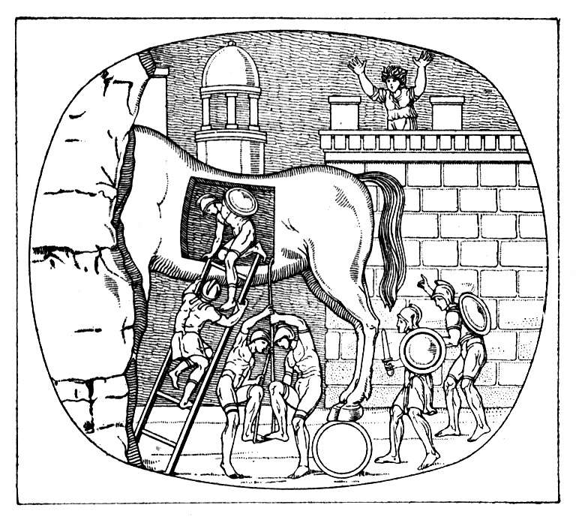
Our testable hypothesis
Initially non-toxic nanoparticles may serve as carriers of toxic compounds into biological systems
Adverse effects may correlate with nanoparticle specific surface area
Image: http://www.php4windows.com/Articles/trojan_horse_in_business_home_software.jpg

Slide 49
Testing this hypothesis, system components
Relatively non-toxic ubiquitous nanoparticles
  Fumed silica, Aerosil
  Evonik, ~ 50 through 350 m²/g specific surface area
Low molecular weight water soluble (~ 2.4 g/L) toxic molecule, cisplatin
Positive control, quartz, ~ 1 micron mass median diameter
Cell line, bovine chondrocytes
Notes:
Quartz - known carcinogen, generates reactive oxygen species

Slide 50
About cisplatin
Cl
Cl
Pt
H₂N
NH₂
Potent antitumor agent used to treat different type of cancers
Cytotoxic mode of action
  Interacts with DNA
  Forms intra-strand cross-linkages
  Leads to activation of apoptosis
Cisplatin and some other chemo agents adversely effect skeletal system of children, thus effects on chondrocytes previously studied

Slide 51
Experimental approach
Attachment of toxin (cisplatin) to non-toxic (fumed silica) surface
Characterization of the surface modified silica particles
in vitro tests on chondrocytes
  Membrane integrity via fluorescence microscopy using the Live/Dead (calcein/ ethedium bromide) stain
  Metabolic function via the MTT (methylthiazol tetrazolium) assay
  Electron microscopy
Notes:
3-(4,5-dimethylthiazol-2-yl)-2,-diphenyltetrazolium bromide

Slide 52
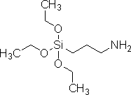
Attachment of cisplatin to silica
~
Cisplatin
under N₂
2% v/v APTES in acetone, overnight, room temperature
O
Cl
Cl
+
O
Si
NH₂
+
Pt
O
H₂N
NH₂
Silica
APTES
~
under N₂ overnight, room temperature
Aminopropyl
triethoxysilane
~
O
Cl
O
Si
NH
Pt
NH₂
O
NH₂
~

Slide 53
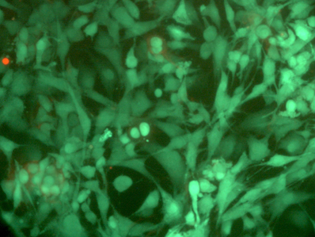
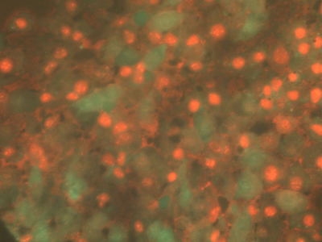
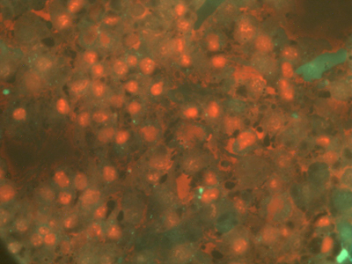
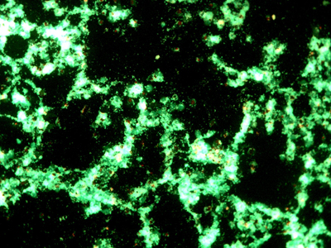
Fluorescence microscopy, Live/Dead stain
24 hrs exposure
negative control
Aerosil 380 only
Aerosil 380+ cisplatin
50 μm
50 μm
positive control
5 μg/ml free cisplatin
positive control quartz
50 μm
50 μm
Notes:
Top left, control
Top right, aerosil 380 = cisplatin alone
Bottom left, cisplatin alone, 5 micrograms/ml
Bottom right, quartz

Slide 54
MTT assay
Cell culture wells washed, then 300 µl of MTT solution (0.5 mg/ml) added
Plates incubated at 37 ⁰C for 2 hrs allowing for reduction of tetrazolium salt to a formazan (blue) dye by active mitochondria of the cells
300 µl of solubilizing buffer (10% Triton X 100 with 0.1N HCl in anhydrous isopropanol) added to dissolve the formazan
Absorbance was measured at 570 nm using microplate reader

Slide 55
MTT results, silica/cisplatin
*
*
*
*
*
*
*
*
*
*
*
*
*
*
*
*
Error bars represent standard deviation of four replicates
Asterisks denote statistically significant (p < 0.05) differences between experiment and control

Slide 56
Correlation
R² = 0.61
R² = 0.76
R² = 1.0

Slide 57
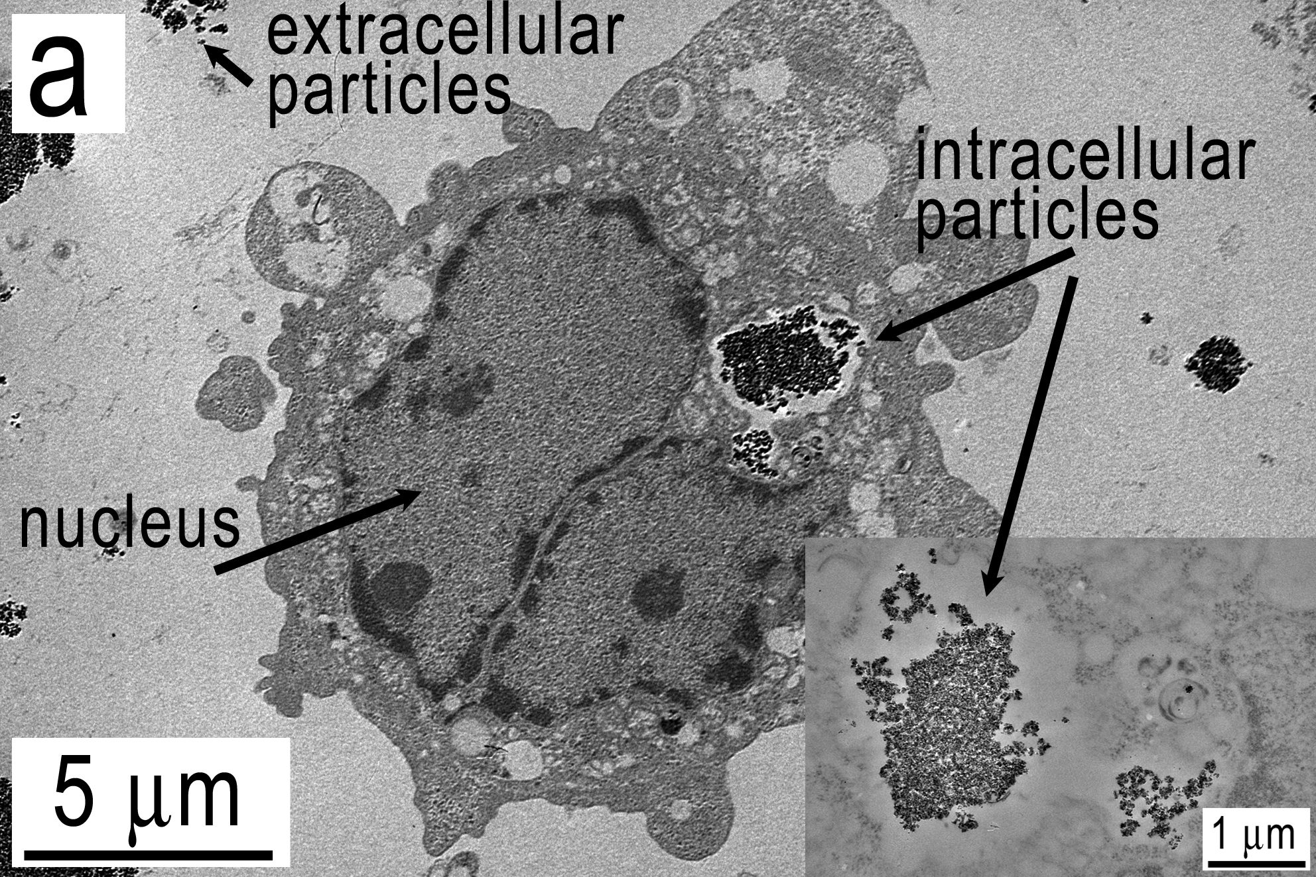
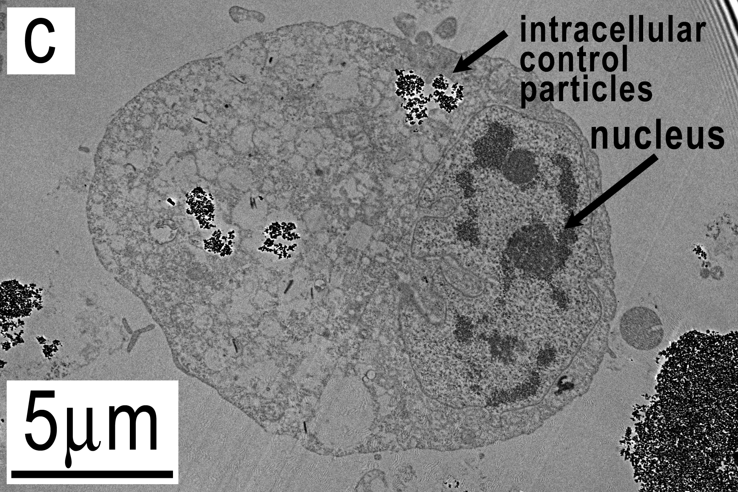
Transmission electron microscopy comparison to control…
b
Qualitative observations
- intracellular particles observed in both
- nuclei more compact in control sample
Notes:
Looked at 50-100 cells from each sample

Slide 58
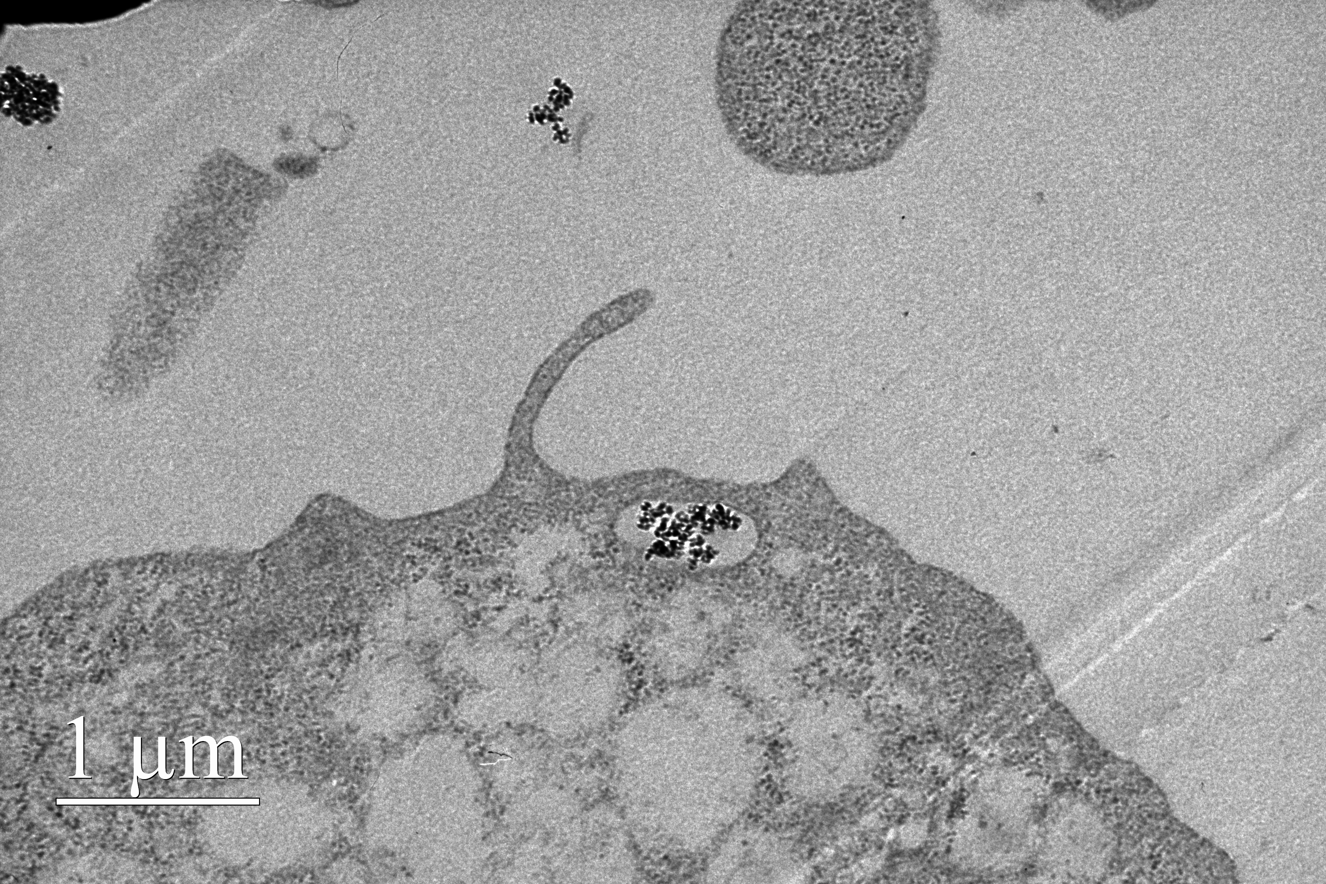
Discussion
Free cisplatin can enter cells by active and passive transport
Adverse effects on cell function may result from
  cells internalizing particles/cisplatin (true trojan horse)
  particles releasing
  cisplatin near the
  cell membranes

Slide 59
Discussion
Metabolic function correlated negatively with surface area
Fluorescence imaging indicates significant adverse effects on cell membranes and DNA
Effects comparable to free cisplatin at 5 μg/ml
No synergistic adverse effects observed, nor did silica mitigate effects of cisplatin on cells
TEM images show the particles are inside the cells
Adverse effects on cell function may result from transport of cisplatin near cells or directly into cells by particles

Slide 60
Take home message
May not be enough to consider nanoparticles by themselves when examining effects of engineered nanoparticles on biological systems
Must evaluate potential for co-release with other compounds, reactive or condensable, that may be hazardous
Must evaluate fate of nanoparticles in the complex environment after release

Slide 61
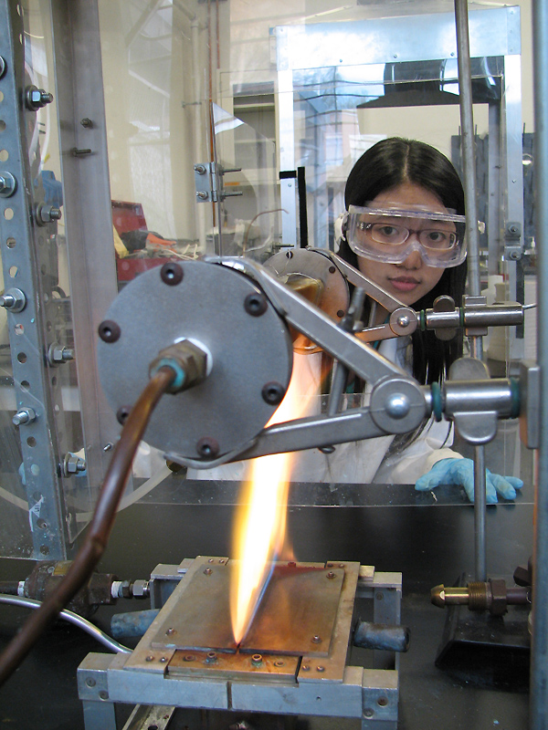
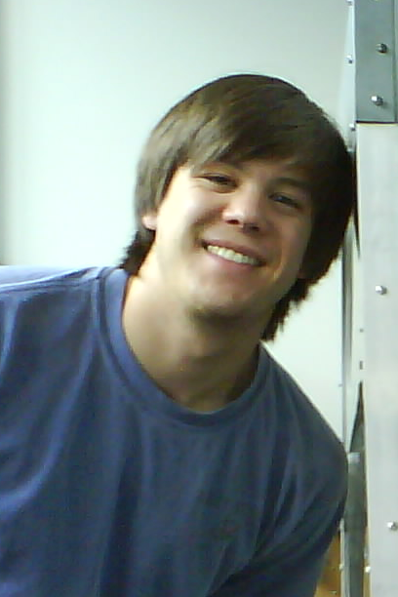


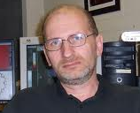



Acknowledgements
Jillian Epstein, REU student
Dr Tridib Bhowmick, Dr. John Fisher
Fishchell Department of Bioengineering
Nick Franson
Kosi Aroh
Yoon Shin
Chia Ying Chiang
+ NIST
Dr. Peter Zavalij
Dr. Karen Gaskell
Dr. Li-Chung Lai

